Slide 1

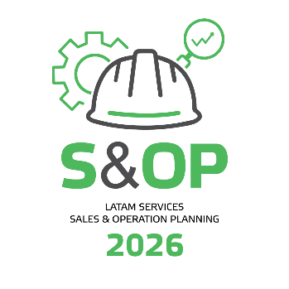
LatAm SER S&OP 2026 - EXPO
Station 1 – Mill Wide Optimization (MWO)
Cristian Baldovino Sperberg
Valmet Chile

Slide 2









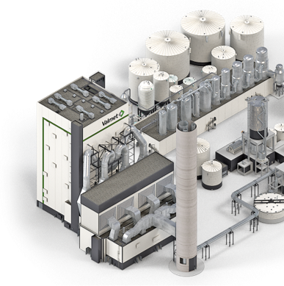

Valmet’s framework for autonomous operations
What is your target level of autonomy?
Manufacturing system optimization
Empowering people to perform at their best
Mill-wide or cross-value chain optimization
Process optimization
Connected, intelligent process technology
BUILDING BLOCKS
AUTONOMY LEVELS
1. Partially automated
2. Fully automated
3. Semi-autonomous
4. Orchestrated
5. Autonomous

Slide 3
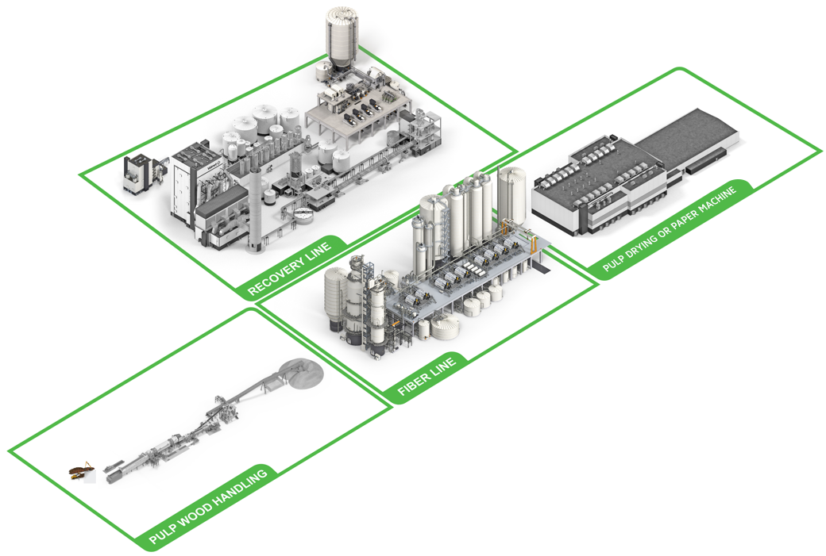
Pulp and paper process optimizers with more than 30 years experience
Optimizing all process areas
Steam Network Manager
Ventilated steam production up to 95% | HP Header variability reduction 50%
Evaporation Optimizer
Increased burning liquor | Dry solids 1-3%
Recovery Boiler + ESP Power Optimizer
Increased production rate 1-3% | Increase electricity production 1-4%
Power Boiler Combustion Manager
Fuel cost decrease 2-10% | Boiler efficiency increase
IQ MD Optimizer (QCS)
Production increase up to 10% | Less rejects in auto grade change up to 40%
15+ references
20+ references
50+ references
30+ references
1000+ references
Pulp to Paper Optimizer
Strength variability reduction up to 35% | Refiner specific energy savings up to 8%
Causticizing Optimizer
Increased production rate | 5-8%
Lime Kiln Optimizer
Decreased energy consumption | 3-7%
60+ references
Bleaching Optimizer
Brightness variation decrease 10-50% | Bleaching chemicals savings 5-15%
15+ references
25+ references
Debarking Optimizer
Wood loss reduction | 0.5-2%
Washing Optimizer
Washing loss decrease 3-10% | Dry solids content increase 0.3-1%
BCTMP Optimizer
Bleaching chemical savings 8% | Specific energy reduction 3-10%
80+ references
Batch and Continuous Cooking Optimizer
Kappa variation decrease 20-60% | Wood yield increase 0.5-1%
5+ references
15+ references
30+ references
50+ references
Notes:
Valmet has been delivering process optimizers, our APC solutions, for over 30 years.
During that time we have developed optimizers for all major process areas in pulp and paper which are currently delivering measurable and sustainable benefits to mills around the world
for fiber lines
the recovery cycle
power boilers and energy management
and for pulp dryers and paper machines.
APC benefits cascade from one process area to another, but solutions for coordinating the actions between process areas towards high level objectives are uncommon. Valmet has been working on such solutions.

Slide 4
Valmet Mill-Wide Optimization (MWO)
Looking at the mill as a whole
Steam Network Manager
Ventilated steam production up to 95% | HP Header variability reduction 50%
Evaporation Optimizer
Increased burning liquor | Dry solids 1-3%
Recovery Boiler + ESP Power Optimizer
Increased production rate 1-3% | Increase electricity production 1-4%
Power Boiler Combustion Manager
Fuel cost decrease 2-10% | Boiler efficiency increase
IQ MD Optimizer (QCS)
Production increase up to 10% | Less rejects in auto grade change up to 40%
15+ references
20+ references
50+ references
30+ references
1000+ references
Pulp to Paper Optimizer
Strength variability reduction up to 35% | Refiner specific energy savings up to 8%
Causticizing Optimizer
Increased production rate | 5-8%
Lime Kiln Optimizer
Decreased energy consumption | 3-7%
60+ references
Bleaching Optimizer
Brightness variation decrease 10-50% | Bleaching chemicals savings 5-15%
15+ references
25+ references
Debarking Optimizer
Wood loss reduction | 0.5-2%
Washing Optimizer
Washing loss decrease 3-10% | Dry solids content increase 0.3-1%
BCTMP Optimizer
Bleaching chemical savings 8% | Specific energy reduction 3-10%
80+ references
Batch and Continuous Cooking Optimizer
Kappa variation decrease 20-60% | Wood yield increase 0.5-1%
5+ references
15+ references
30+ references
50+ references
Notes:
The benefits of individual optimization solutions are well documented, but we believe there is untapped potential if we can automate decision making at the mill level to coordinate process areas to work together towards common objectives, such as increased production, reduced cost per tonne, and improved quality of the final product.

Slide 5
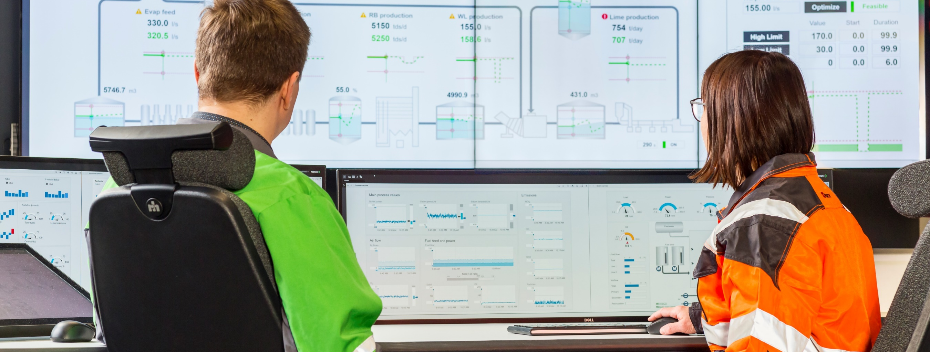
Typical decision making challenges at the mills
Areas where mill-wide optimization could help you
How do I manage my inventories to meet the production plan most efficiently?
I want to push as much production as I can, taking into account mill restrictions and the resulting energy demand for each mill department.
I want to stabilize the production, even during unplanned process disturbances.
I want to optimize my
raw material and furnish blends to achieve quality at lower cost.
Coordination decisions
currently based on soon-to-retire operators’ knowledge and spreadsheets. We need better tools in the future.

Slide 6
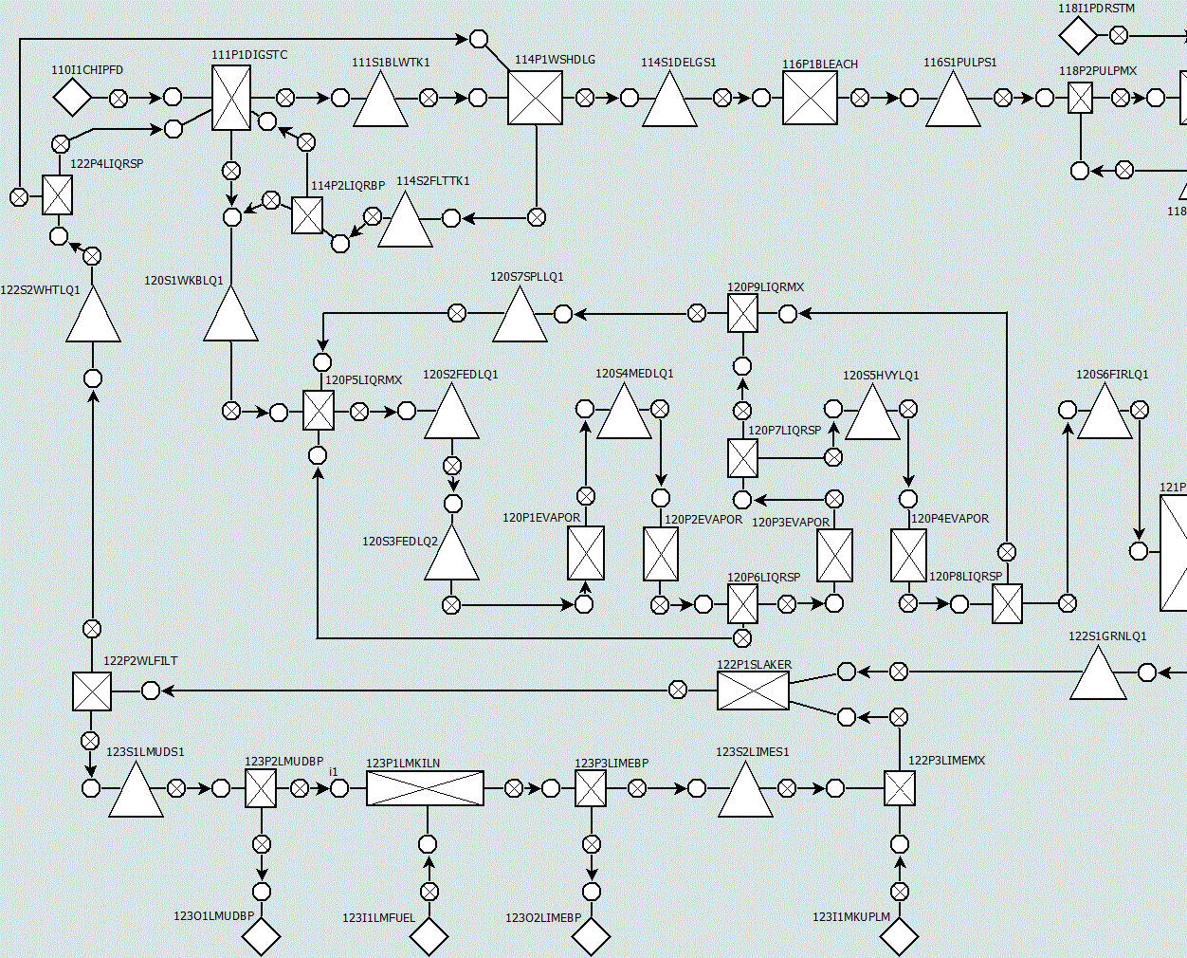
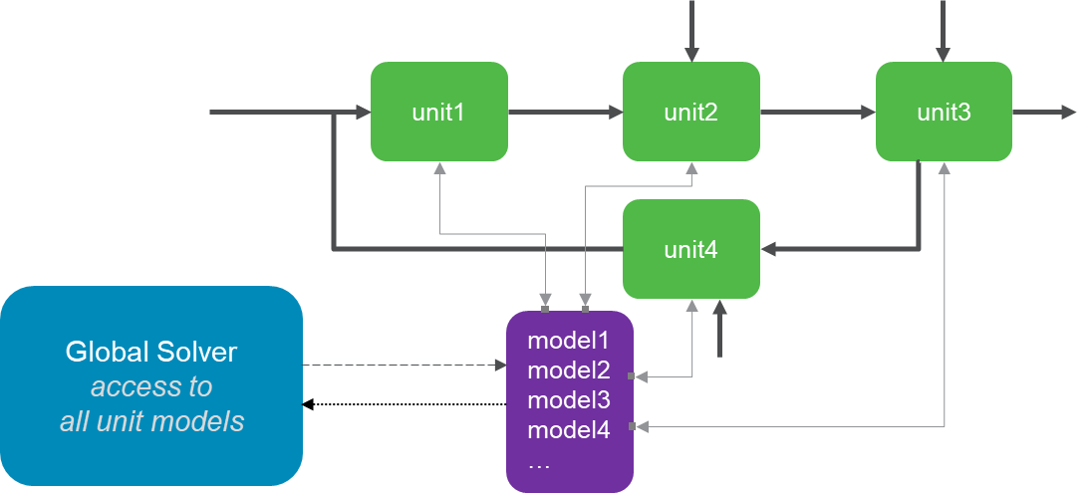
High-level digital twin of the whole mill
Process flowsheet optimization
Mill modeled as a flowsheet of connected unit operations
Process models are embedded in unit operation modules with relevant input-output relationships
Pulp and liquor components and properties are tracked through the flowsheet
Ability to define process costs, profit, targets, high/low limits, rate limits, smoothing factors, etc.

Slide 7








Valmet Mill-Wide Optimization (MWO) Implementation
Change Management Process & Activities
MWO Workshop & Audit
Assess readiness for change
MWO Solution Design
Plan and communicate new roles and WoW
MWO Testing & Training
Test solution together
Train users by role and get feedback
MWO Utilization & Tuning
(3 months)
MWO Service & Support
Review ways of working (WoW)
Design solution together
Update solution together
Continuously collaborate
Actively use MWO in WoW
Incorporate MWO into WoW
Improve solution together
Daily review of MWO advice together
Coach users
ASSESS
PLAN
TEST & TRAIN
REVISE & ASSIST
REINFORCE
MWO has the potential to transform the way decisions are made at the mill level
Mills should be prepared to make changes to their ways of working (WoW)
To ensure success:
Build a change management team
Set clear goals and define a strategy
Plan for obstacles
Ensure continuous improvement

Slide 8
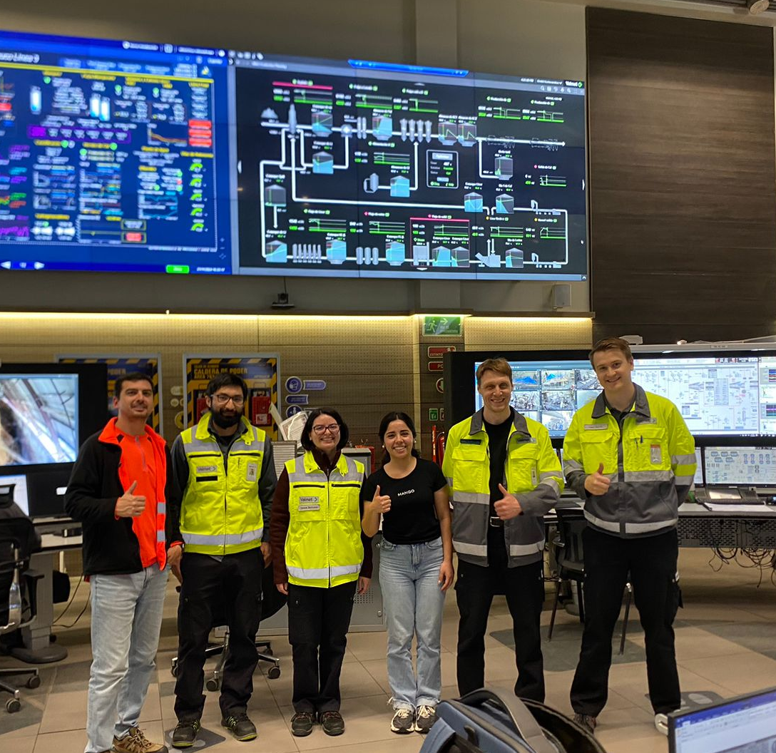
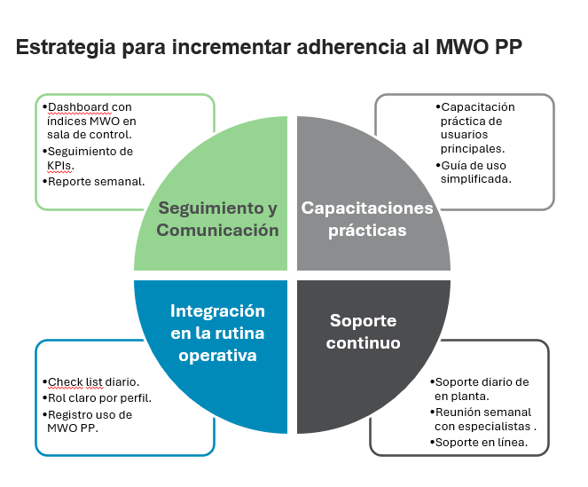
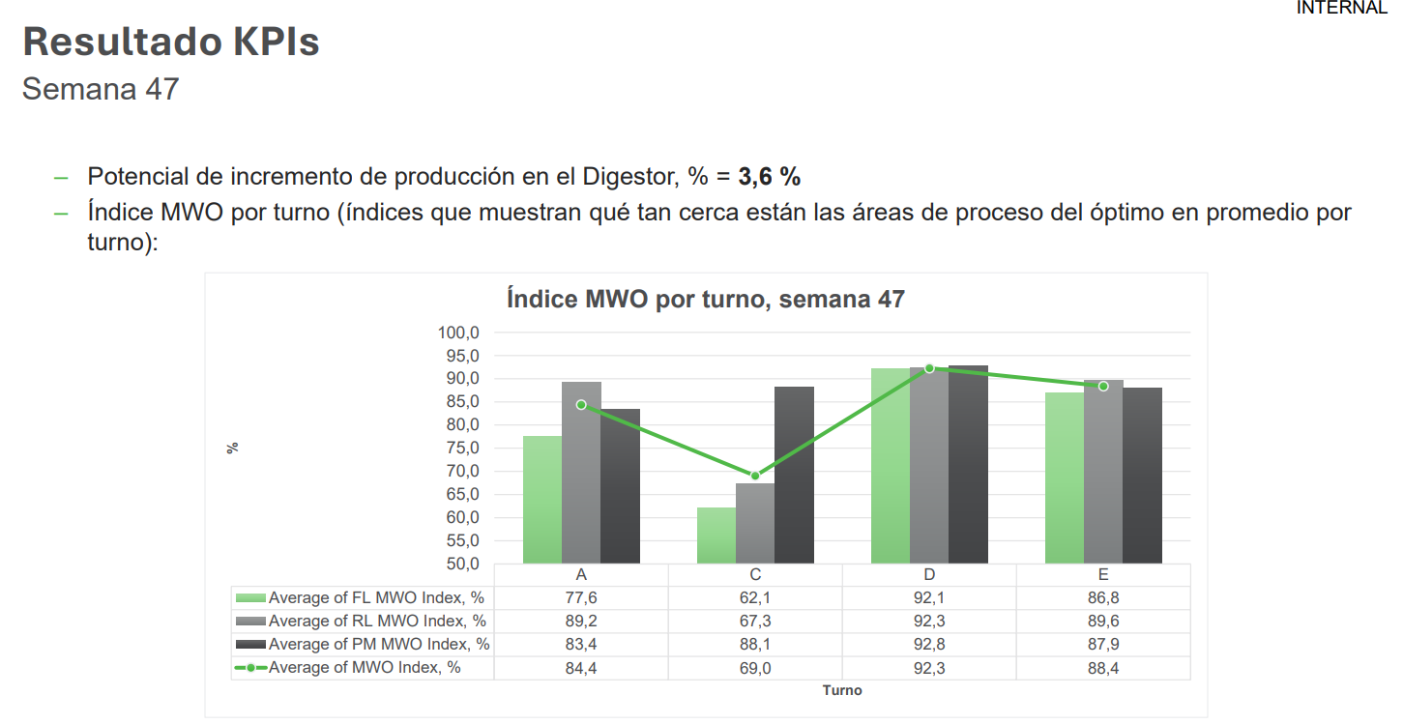
MWO – Arauco L3
Scope of the contract
MWO Production Planner
MWO Quality Tracker
MWO Cost Tracker
MWO Quality Planner
5,5 Years (1,5 Years of Implementation
Good Practice
High level of comitment of the Managers
Mill Focal Point is the Leader Automation Optimization Department
Adherence Plan with commitment from top manager
Define KPI´s and Sistematic FU
Full Screen – Video Wall.
Challenges
Mill stability
Culture
Key Users Training (adjust parameters)
Fine tuning were made after delivered – customized solution
Man at the Mill skills to carry out small - Fine tuning.

Slide 9
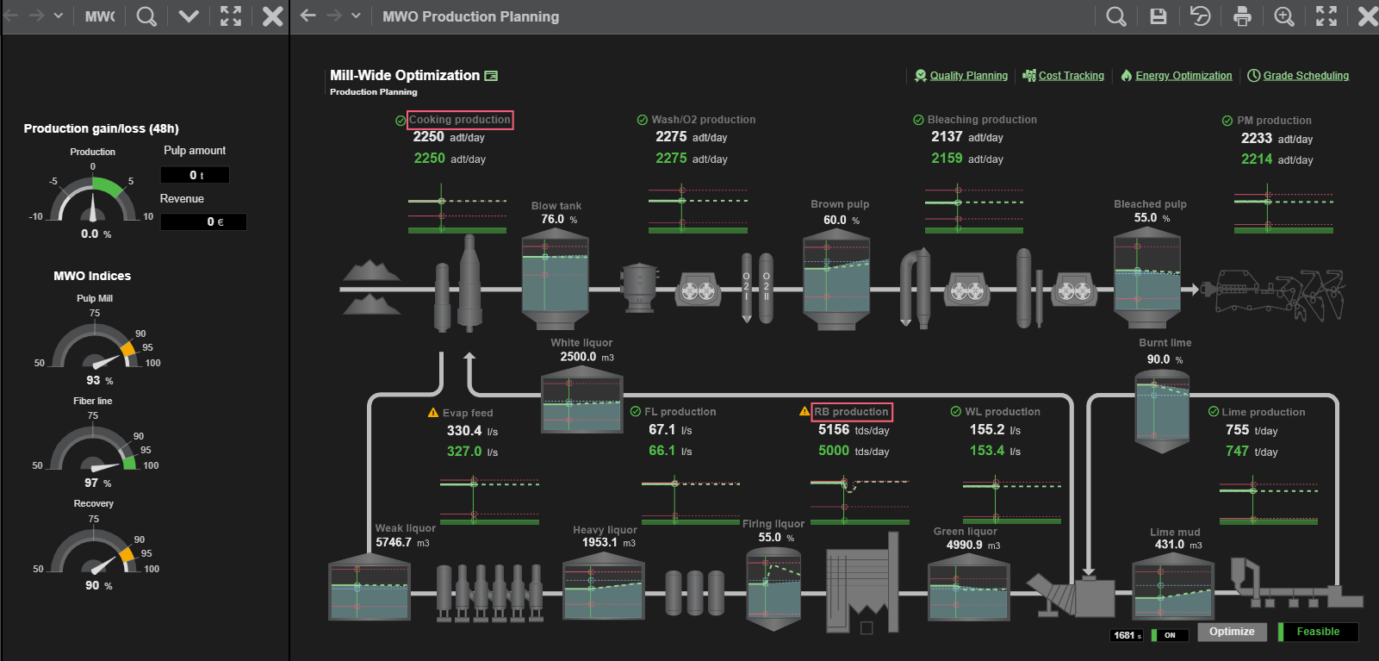
Now!!!
Lets go to the MWO

Slide 10


