Slide 1


LatAm SER S&OP 2026 - EXPO
Station 02 – DNAe & Asset and Performance Management Tools
Helder Alves Batista

Slide 2
Valmet DNAe technical overview

Slide 3
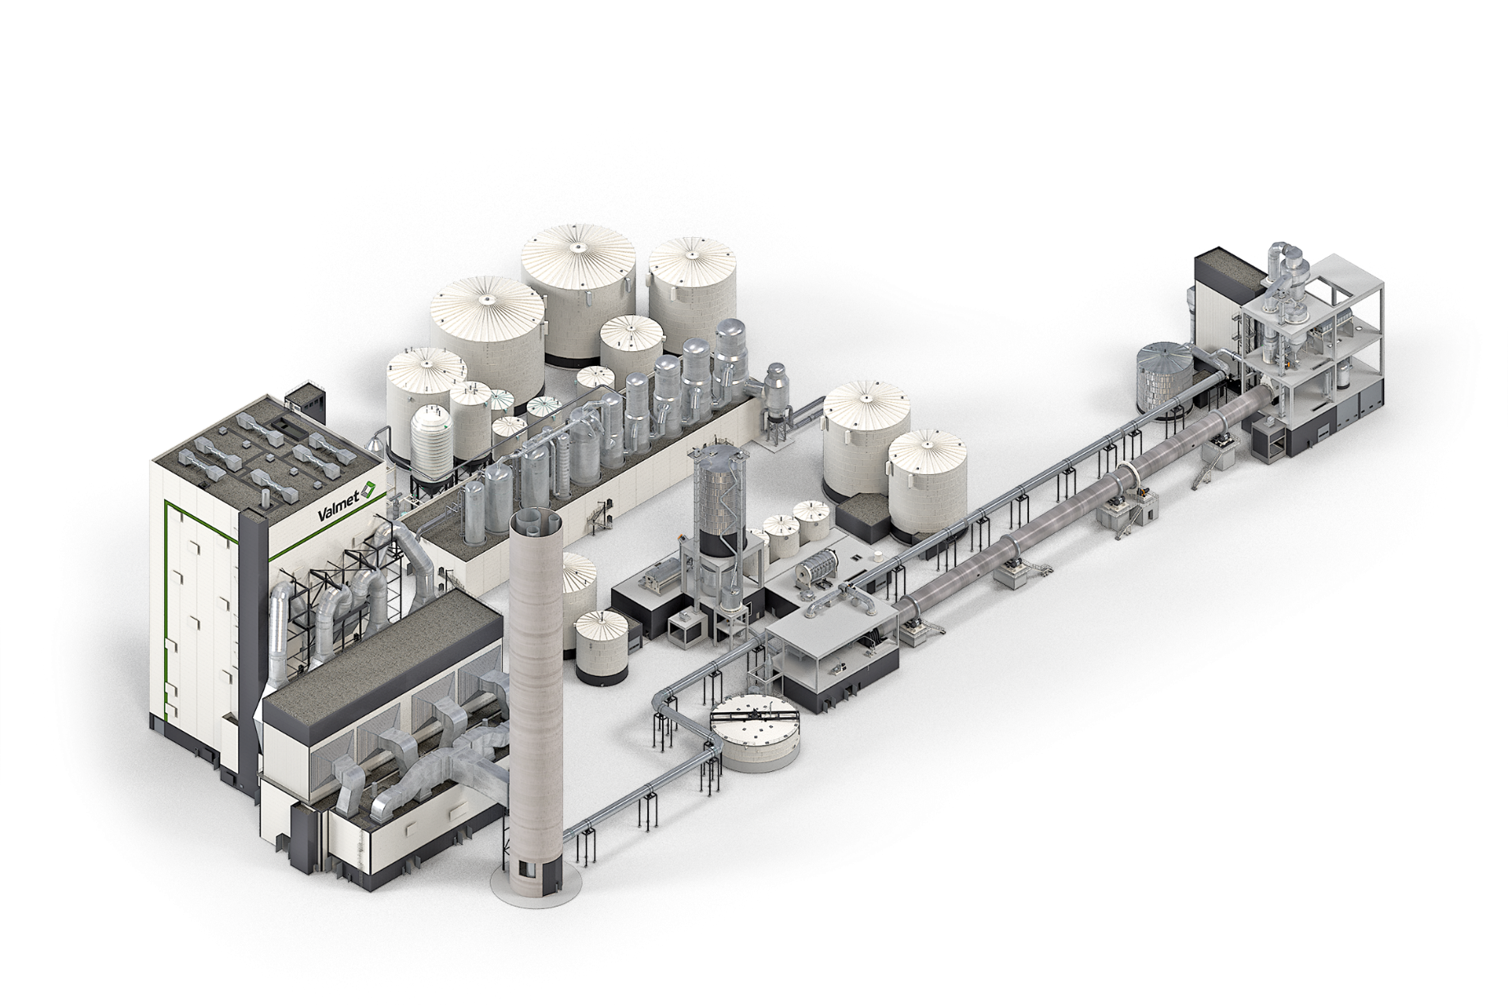
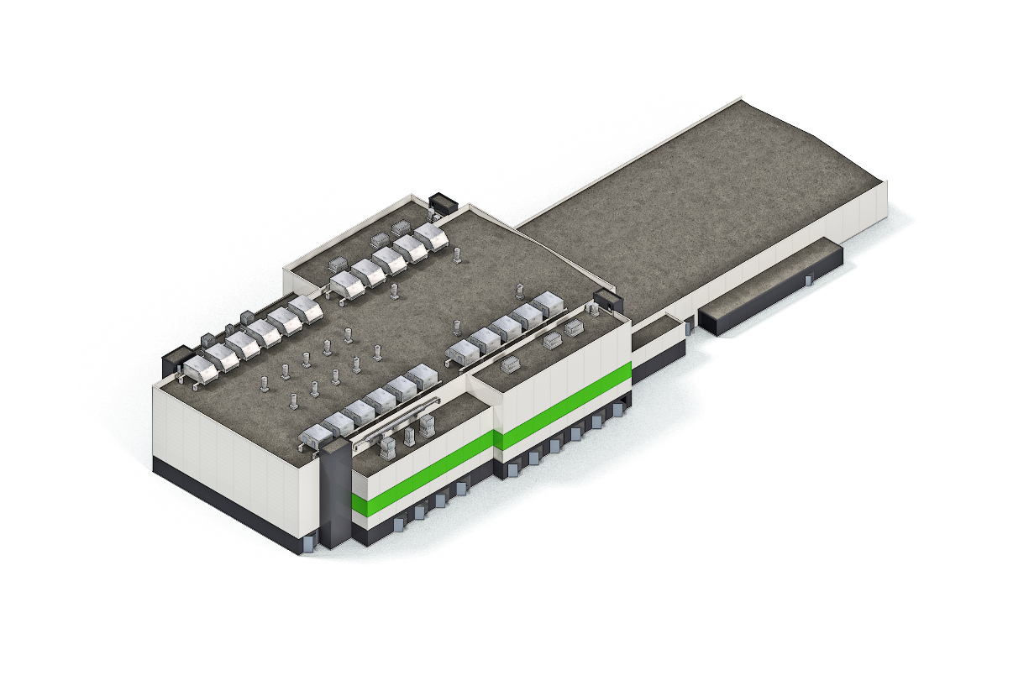
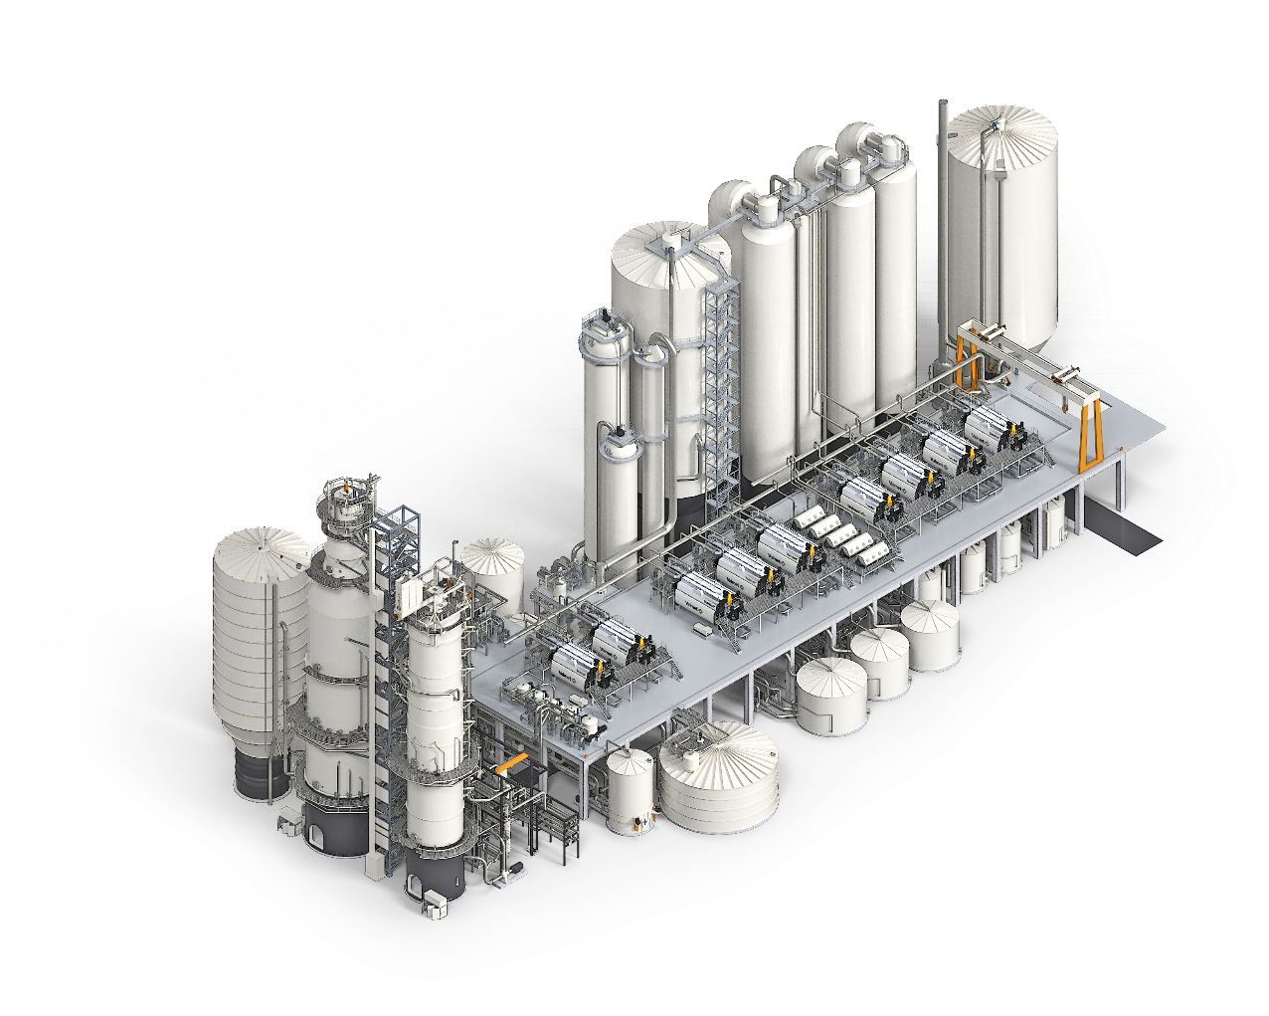
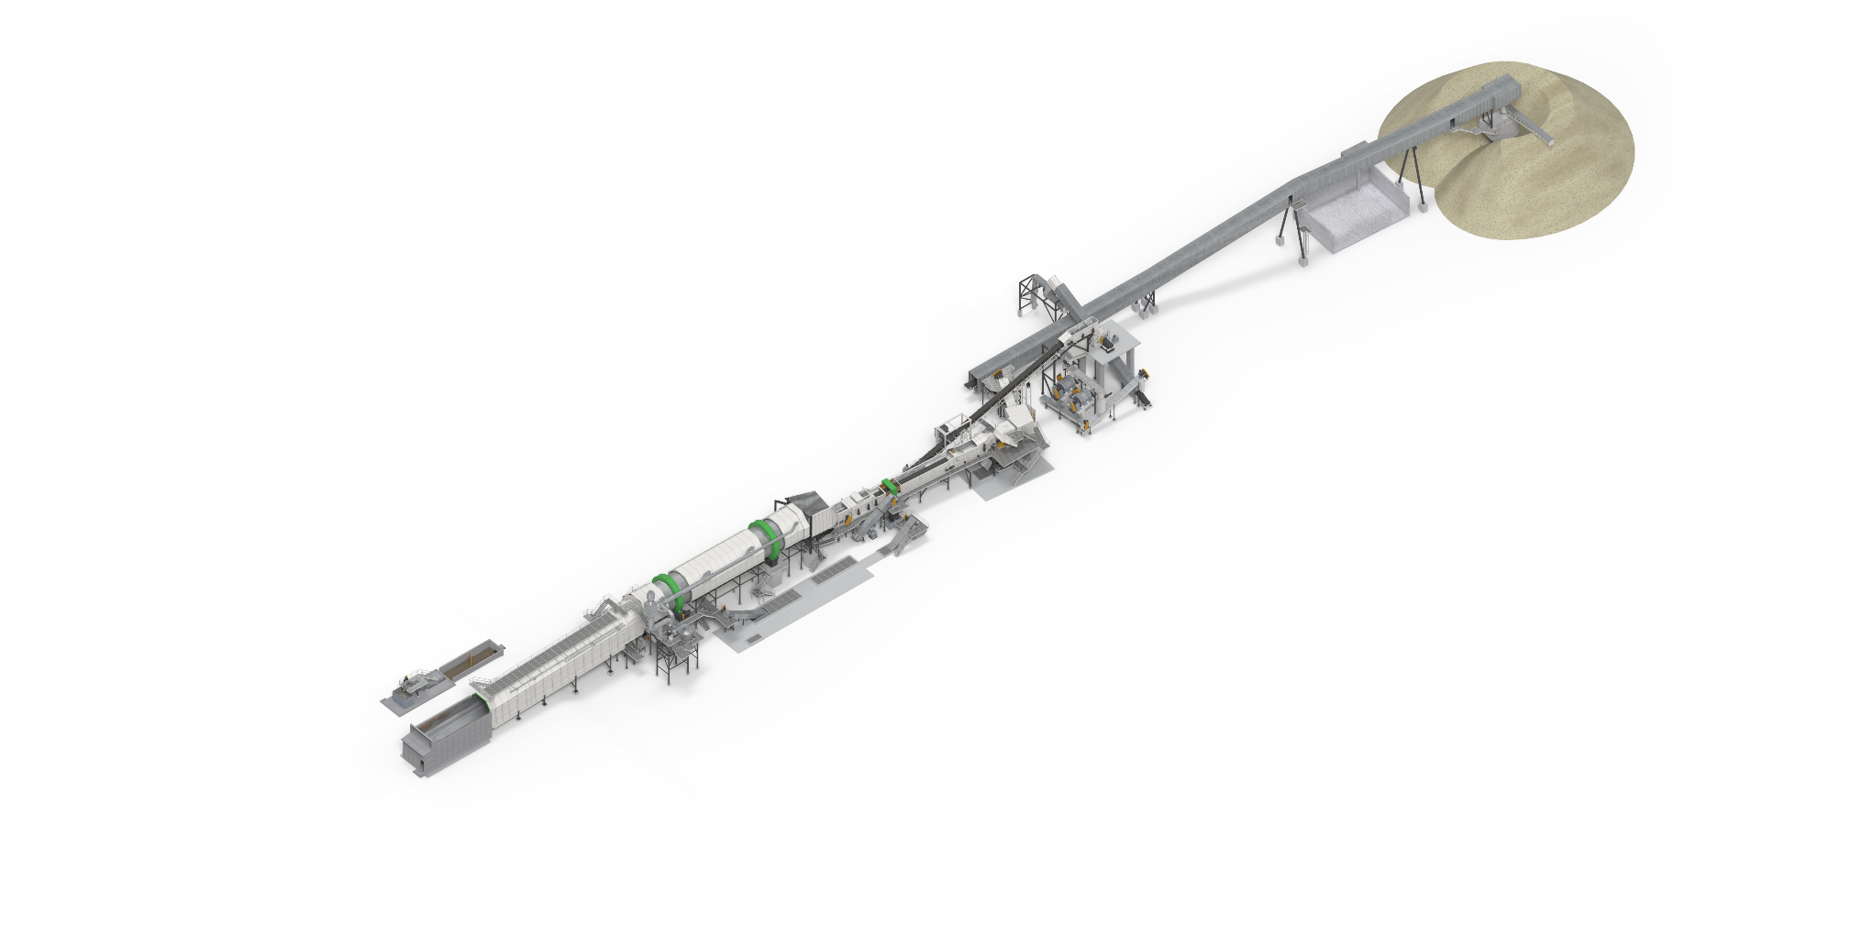
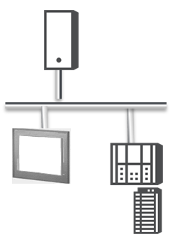
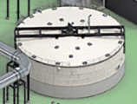
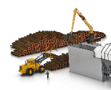
The architecture scales from small to large automation solution
Scalable in size and functionality
The
Plant- or mill-wide automation with Valmet DNAe
A plant or mill may have
  Over 100.000 control signals
  Plant-wide or multi-site automation network
  Central control room, local control rooms, local panels, remote users
  Various information management and data analytics needs
Many different process areas and machines
  Over 20 process areas with their own sub-processes
  Over 30 machines with machine control system functionality including also fast controls like turbines and drives
  Special automation needs in all automation levels from basic to advanced
Wide area with many buildings and rooms
  Over 50 electrical rooms with housing of IE&C equipment
  Installations in field environments
A large (>100 000 I/O)
Plant-wide or multisite automation network
A small (<100 I/O)
stand-alone system
A small
stand-alone
process control need
Notes:
DNA good scalability stays and extends especially on smaller systems
No upper limit on sizing

Slide 4

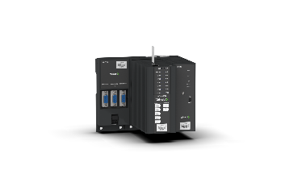
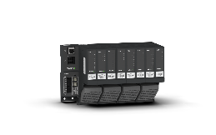

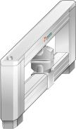
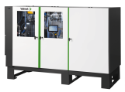
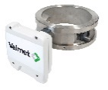



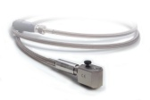
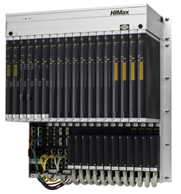
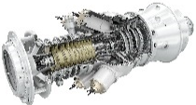
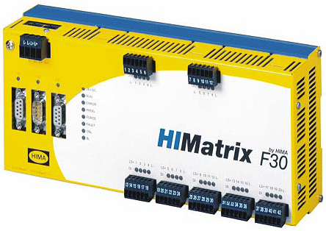
Unified platform for all I/O and controller needs
Single platform delivers reliability and cost efficiency
Full hardware range for processes, machines, quality and drive controls, optimization, and asset management, including field device and vibration monitoring
Easy operation through the unified user interface and alarm handling
Unified history data collection and trending
Common engineering tools for all products
Integrated safety-related controls
Robust with no links between systems
Simplified spare parts and training
Process controls
and advanced process controls
Quality controls
and optimization
Drive controls
Machine condition monitoring
field device asset management
Integrated safety
instrumented system
Machine controls
Notes:
Selection of controllers and I/O is same for all applications

Slide 5









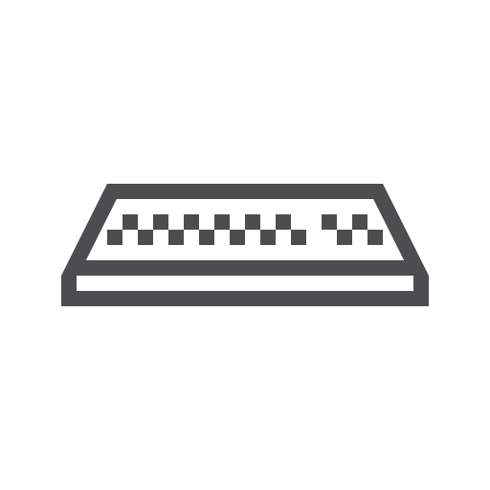




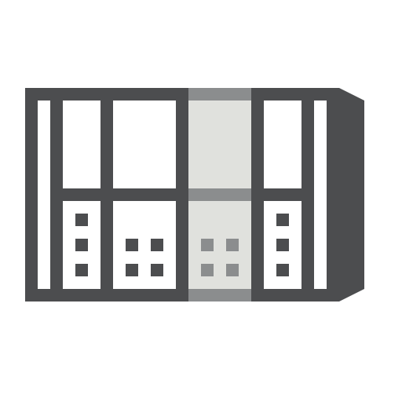

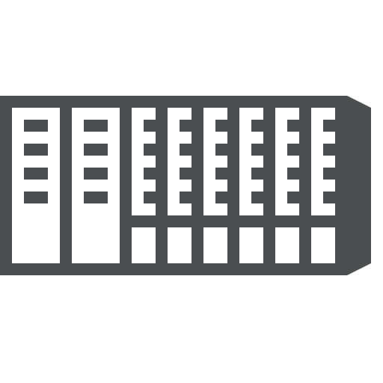

Valmet DNAe Component Architecture
OFFICE & WORKSHOP USERS
Reporting
Data analytics
Asset Management
Engineering
EDGE
Industrial Internet & cloud connection
INDUSTRIAL INTERNET
Enterprise integration
Valmet Services
Remote Alarm
Cyber security updates
Plant Network
IT / OT segmented
IT / Office network
CONTROL ROOM & REMOTE USE
Operation
Maintenance
Reporting
Data Analytics
Asset Management
SYSTEM SERVERS
Historian
Calculations, data analytics and reporting
Configuration and maintenance
Cybersecurity
User / AD management
Remote access
ERP connection OPC UA
Automation DMZ
Server or
Virtualized solutions
CONNECTIVITY TO 3rd PARTY SYSTEMS
PROFINET
PROFIBUS
OPC UA
Modbus
IEC 61850 etc.
PRP Network
Controllers
Controllers
Automation (OT) Network
Subnets firewalled
Safety System
I/O
I/O
Notes:
Edge solutions
Alarm server (ALS) and History buffer (CIM-IO) integrated to controller
PRP network for high availability
Several security measures:
New Valmet proprietary communication between the nodes (TIF Protocol)
Firewalling (security) between the layers and subnets. Network templating.
Automation system server functionalities based on Linux OS
Linux based UI client

Slide 6
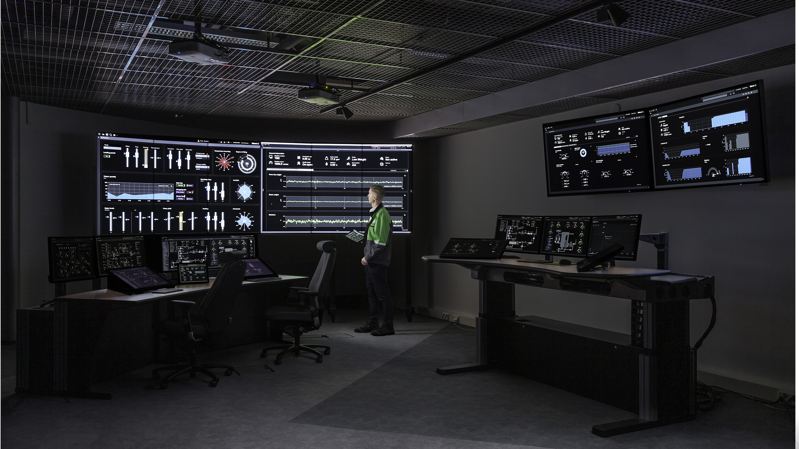
Notes:
Today we have over 50 references, new sales cases UI will now part of new Board line DNA automation

Slide 7
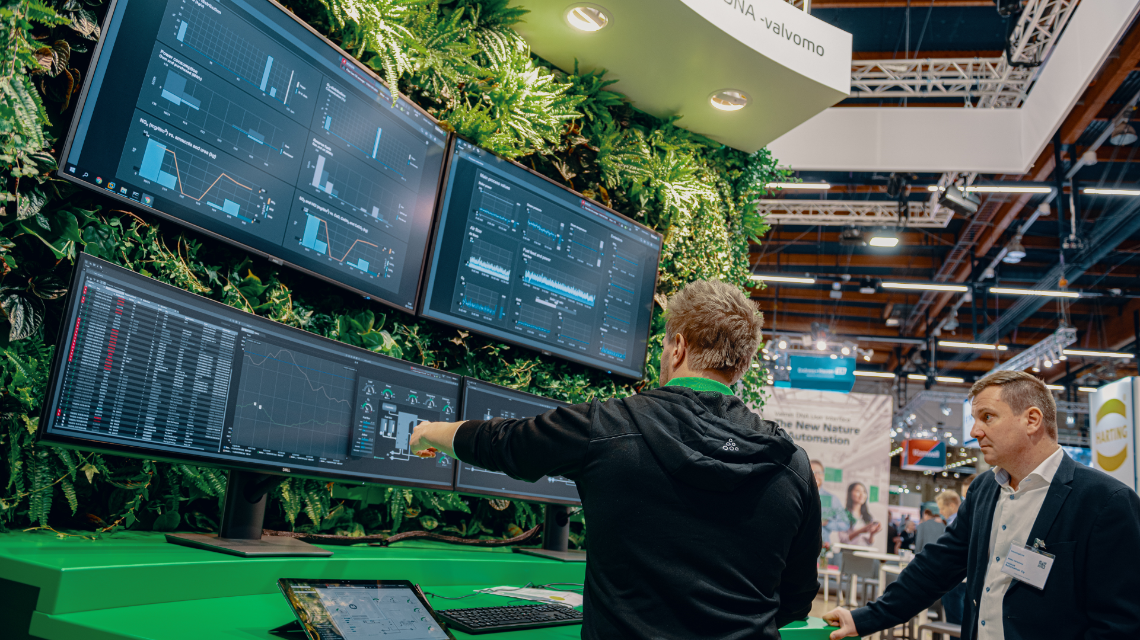

Slide 8

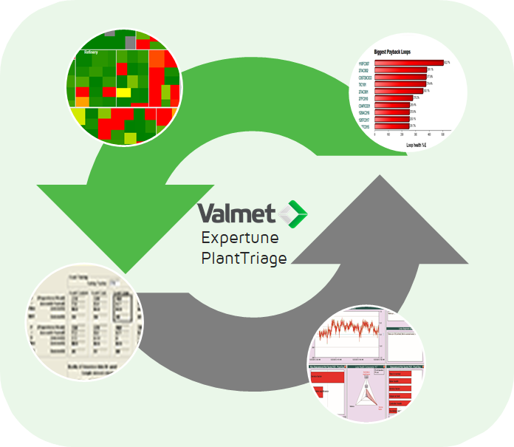
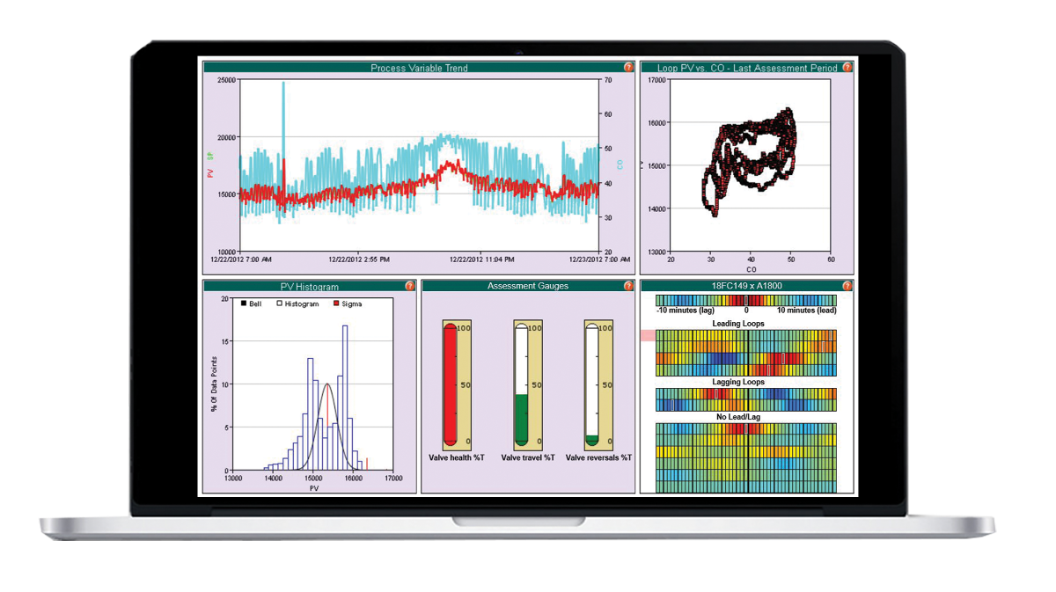


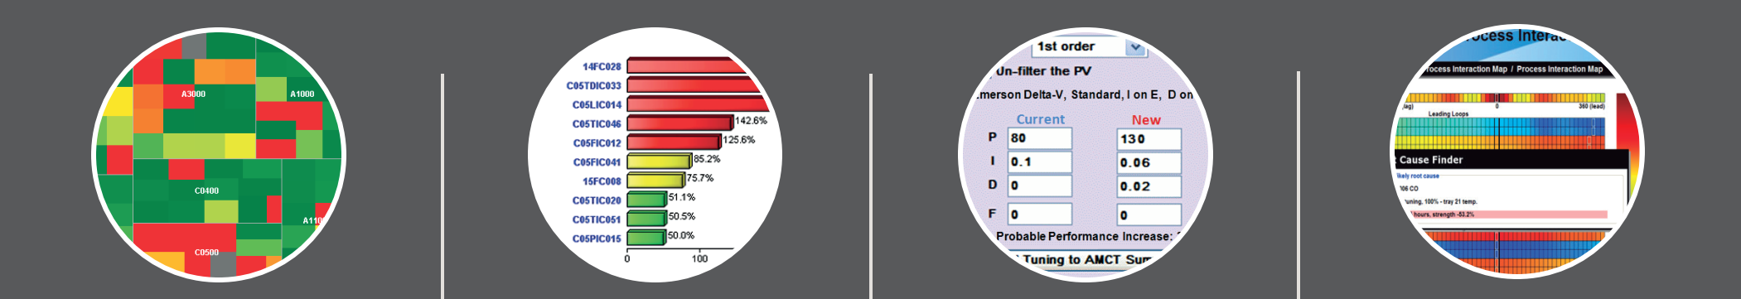


Valmet PlantTriage software
Application
Monitor
Prioritize
All process industries
Reduce energy and general input costs
Resolve
Diagnose
Better plant reliability and availability
Valve Diagnostics (Stiction, Hysteresis, Oscillation, Variability, bad sizing)
Monitors the plant 24/7 in real time
Directs you to the most pressing problems with the greatest economic impact
Resolve issues in instruments, valves and loop tuning
Finds the root cause of oscillations and process upsets and tracks them

Slide 9
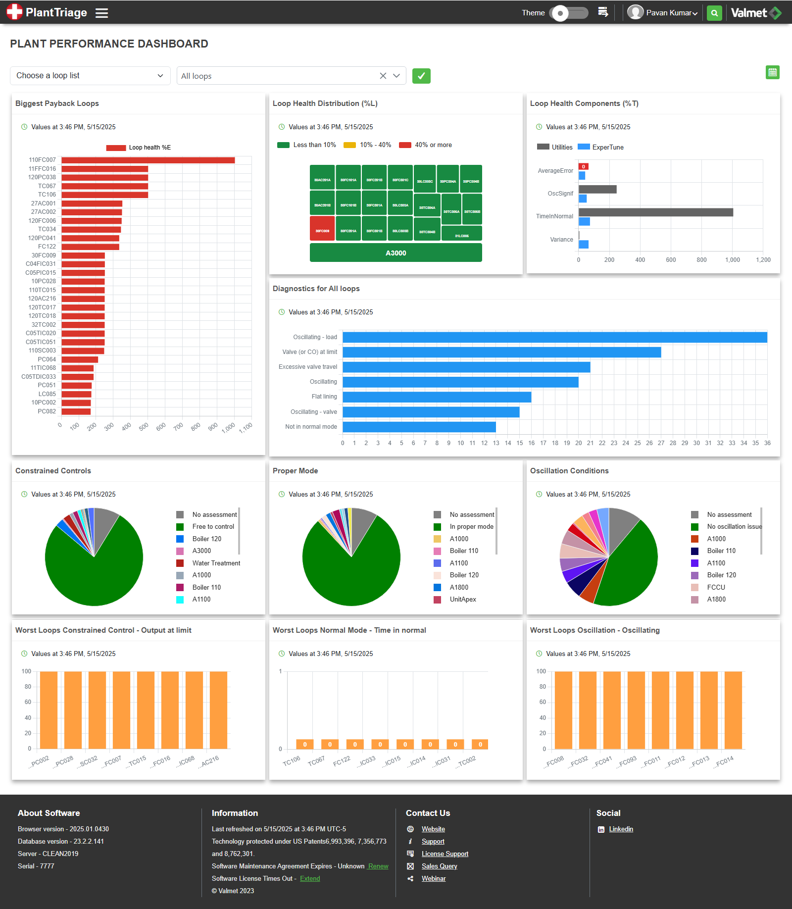
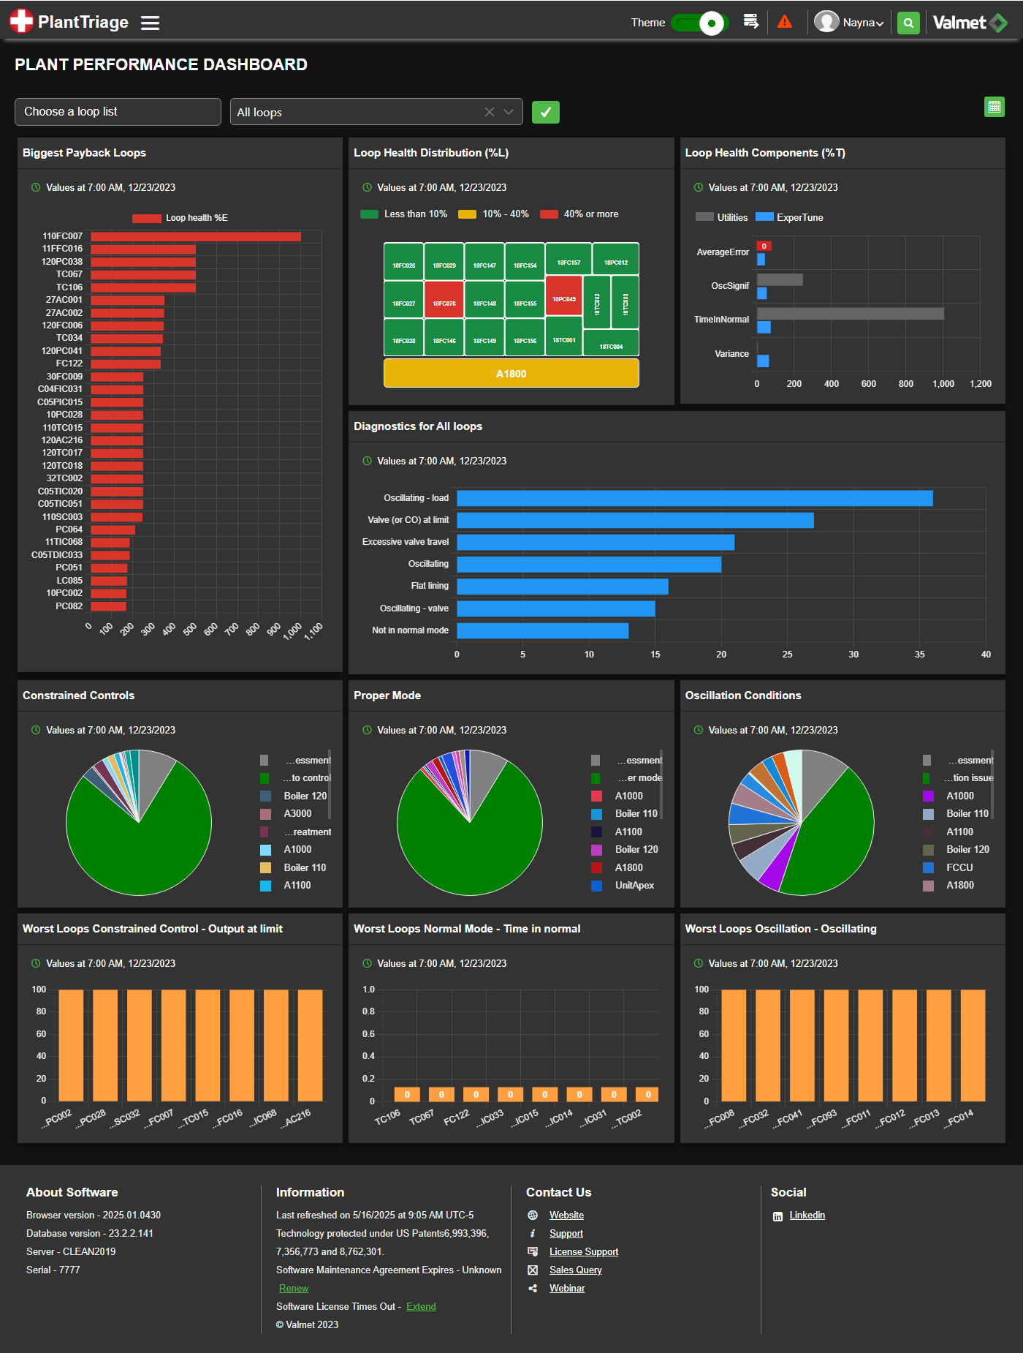
Browser UI light/dark mode toggle

Slide 10


