Slide 1


LatAm SER S&OP 2026 - EXPO
Station 08 – Financial Guarantees
Laurine Afornali

Slide 2
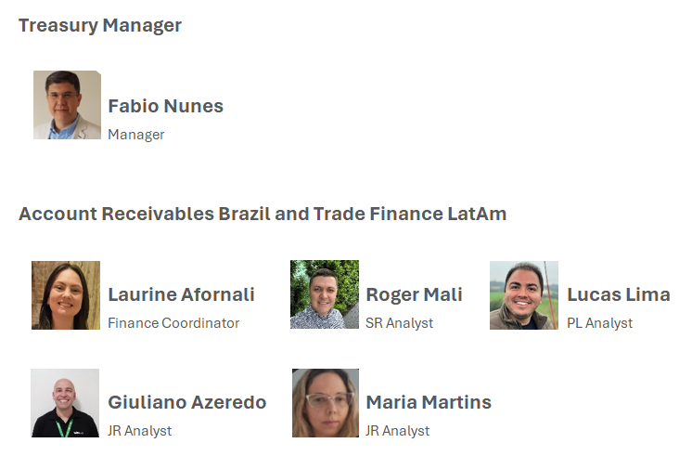
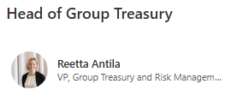
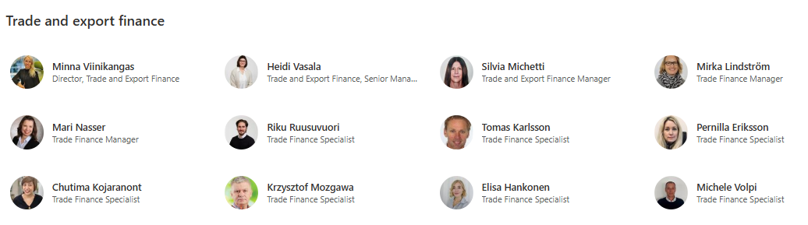
Domestic Support
Global Support
TLatAm – Treasury (Trade Finance)

Slide 3
Why should we know about Financial Guarantees?
It’s the mainly financial instrument requested from customer to release the down payment
To know the best model for each contractual milestone according to the Guarantee Principles
To understand the costs involved
It’s a part of the Section A in the Global Contract Policy
SECTION A
Any exception to Section A is subject to written pre-commitment by the General Counsel of Valmet Oyj and the President(s) of Business Line in question and can be granted only by the President and CEO of Valmet Oyj. Any request for exceptions shall be presented to the President and CEO by the respective Business Line President(s) in question.
LatAm – Treasury (Trade Finance)

Slide 4
What types of Financial Guarantees?
Corporate Guarantee
Letter issued by Valmet Corporation, with the same obligation as a Bank Guarantee.
Bank Guarantee
Letter issued by Banks.
SBLC (Stand-by Letter of Credit)
Letter issued by banks to foreign customer.
Insurance Guarantee
Letter issued by Insurance Company.
This kind of security is not allowed for Brazilians domestic customer, due the Central Bank Legislations.
This kind of security is not allowed by Valmet Brazil. It’s under discussion with Global Treasury.
LatAm – Treasury (Trade Finance)

Slide 5
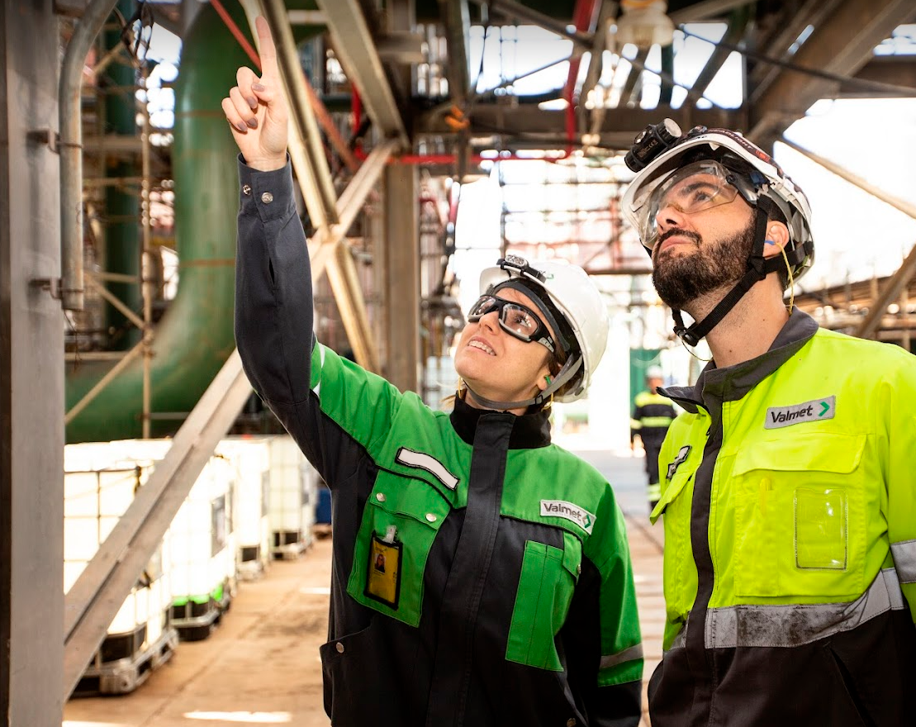
What are the modalities of Financial Guarantees?
Advance Guarantee (= to the Down Payment)
Performance Guarantee (up to 10%)
Warranty Guarantee (up to 10%)
Usually for Down Payments;
Eventually for events without any document delivered;
Valid up to last main shipment date.
ECA to PA;
PA to FA.
For the scheduled completion of performance test:
Not usual;
Issued from PA to the scheduled end of warranty period.
LatAm – Treasury (Trade Finance)

Slide 6
What should be negotiated during the negotiation phase?
Type and Value of Financial Guarantees
Advance Payment, Performance Bond, Warranty Bond
Validity and Conditions
Linked to contractual milestones and project completion
Valmet GuaranteeTemplates
For Projects, always attach the Valmet Guarantee Template in your Commercial Proposal
No general contractual obligations/performance guarantees allowed
LatAm – Treasury (Trade Finance)

Slide 7

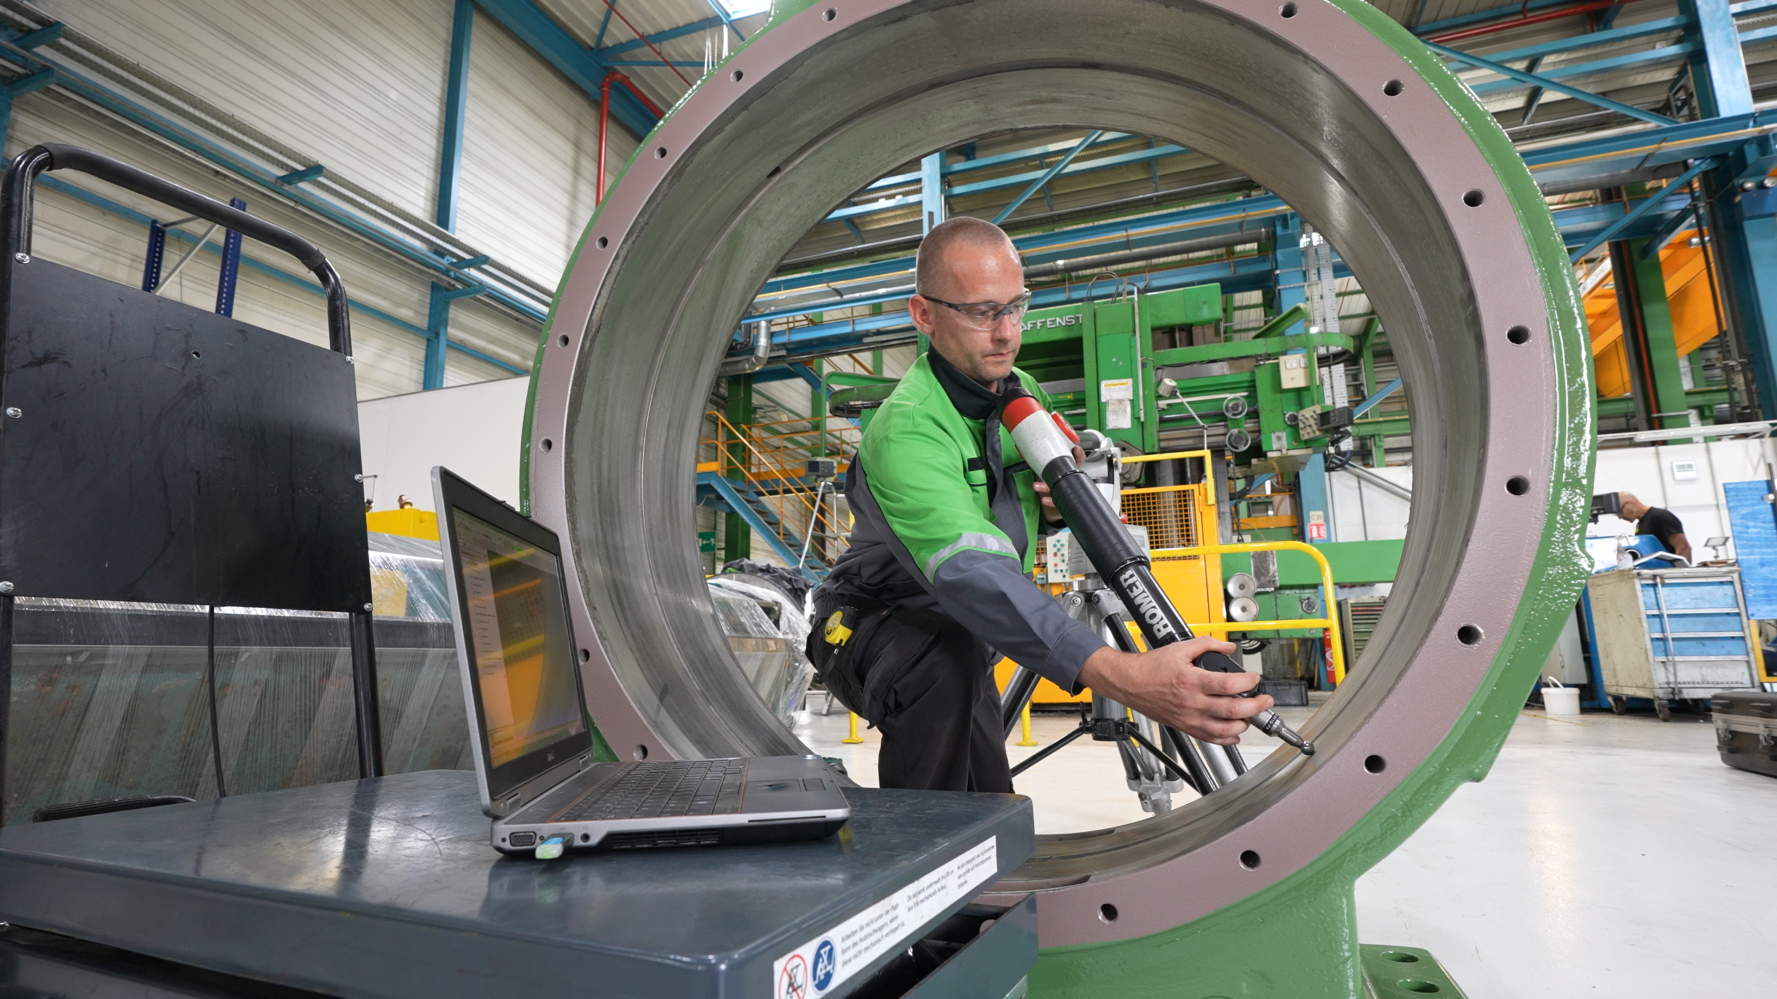



What documents are required to request a bank guarantee and to book a project?
Signed Contract; or
Order Acknowledgement (OA) with the receiving evidence
Purchase Order
Commercial Proposal (with T&C)
Guarantee Form (filled)
LatAm – Treasury (Trade Finance)

Slide 8

Obrigada!
Gracias!
Thank you!
LatAm – Treasury (Trade Finance)

