Slide 1

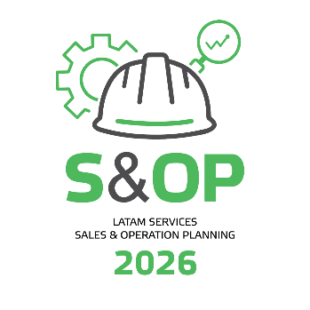
LatAm SER S&OP 2026 - EXPO
Station 10 – Lifecycle services tools for Green & Brown fields business models
REGIS ALVES
ROGERIO FERNANDES

Slide 2

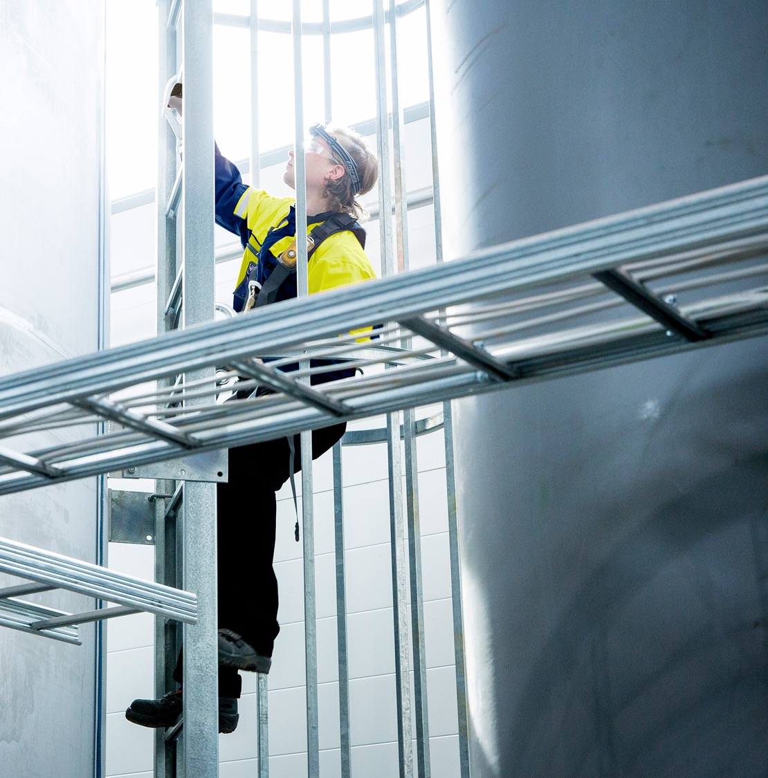




Health, safety and environment at the heart of everything we do
We believe that all incidents can be prevented
Health, safety and environment (HSE) is built into our products and services, and we put it at the forefront of every decision we make
Sustainability
Continuous improvement of safety and the goal of zero harm in all activities at our own and customers’ premises.
www.valmet.com/about-us/sustainability/
We are committed to taking responsibility for our own safety and for the safety of others
We are committed to minimizing our environmental footprint throughout the entire value chain: saving energy, resources, and effort
Notes:
Before going to deeper to the topic, let’s talk about safety.
For us, safety always comes first. We take pride of our safety culture, which is putting Health, safety and environment (HSE) in the core of everything we do
Building a leading safety culture begins with right mindset: we believe that all incidents can be prevented
We are committed to taking responsibility for our own safety and for the safety of others as well as minimizing our environmental footprint throughout the entire value chain
This becomes reality when HSE is part of every decision we make. We are committed to the continuous improvement of safety and the goal of zero harm in all activities at our own and customers’ premises.
Read more about our safety and sustainability agenda at neles.com
Energy savings comes from:
Reduced use of compressed air from valve and positioner improvements
Process optimization using PlantTriage
Save resources and effort by working together smartly, planning effectively, and reducing unplanned downtime.

Slide 3
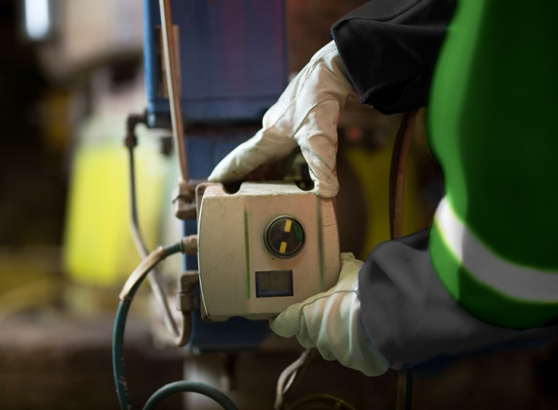

Valmet’s flow control services briefly
Over 400
experienced field service experts globally
Market-leading expertise in shutdown management
65 years of valve technology knowledge and experience –
45+ years of valve service
We are involved in
150+ shutdowns and 100+ service agreements globally
Forerunner in digitalization and diagnostics
Pioneering the use of data to
improve process reliability
since mid-90s
Over 20,000 overhauled valves and
3,000 site visits per year
~ 40 service centres in more than
20 countries
Notes:
Our flow control business has a long history of excellence in valves. As you can see from this slide, we support you with deep experience, and a global network of expertise, and cutting edge technologies, applied locally through your in-country and in-plant support team.

Slide 4
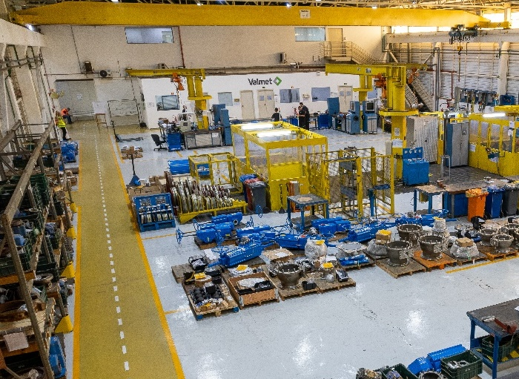
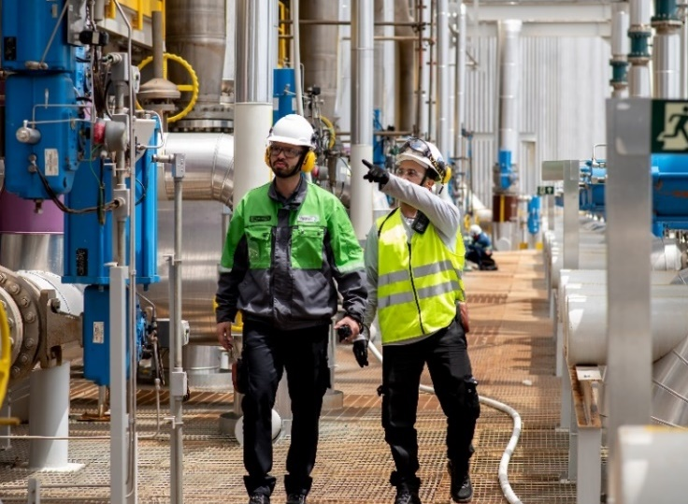

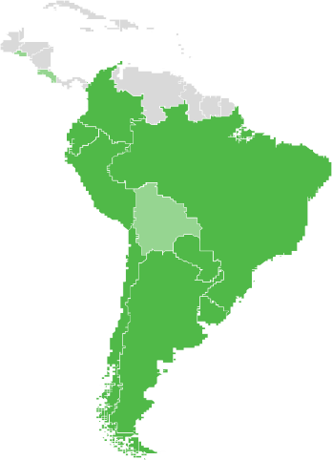
Flow Control – Latin America in brief
Locations
Brazil:
Sorocaba Valve Technology Center
Chile:
Antofagasta Service center
Concepcion Service center
Santiago Sales Office
Mexico: Sales Office
Main customers
P&P: Arauco, Klabin, Suzano, CMPC
M&M: Vale, Codelco, BHP, FLS
R&C: Braskem, Petrobras, Pemex
RE&G: FS Agro, White M, Adeco
New building in Sorocaba
Double the production capacity
Changing operations: ATO to ETO
Start operating in Q2/2026
Frontrunner in digitalization and diagnostics for valves
Partner in sustainability
Bringing sustainable solutions and providing savings in supplies, energy and CO₂ consumption to all industries.
Supporting customers through services and residents for a faster
decision making
Supporting main costumers
in Latin America

Slide 5


Custom lifecycle service solutions
Digital tools
+
Expert services
+
Best practices
Capital project
start-up services
Operate, maintain
and optimize
Shutdown services
Modernization and upgrade services
→
→
→
Partnership agreement with common goals and KPIs
Notes:
We offer you an entire scope of valve services and can support you throughout the entire lifecycle of your plant.
These services are discussed in more detail in the following pages:
- Capital project start-up services
- Operate, maintain and optimize
- Shutdown services
- Modernization and upgrade services

Slide 6
Capital project start-up services
Smooth transition to operate and maintain
Digital document handover
Simple, error-free transfer from engineering to operations.
Installation supervision and support
Quick resolution of issues with valve installation, orientation, damage during transportation, etc.
Testing and documentation
Reduce risk of start-up delays. Confirm the valve assembly meets performance specs.
Troubleshooting and instrumentation
Quick resolution of issues with valve installation, orientation, damage during transportation, etc.
Operation and maintenance training
Avoid costly mistakes. Ensure proper operation to maximize equipment lifespan and reliability.
Prepare plant systems (ERP, CMMS)
Your plant systems are ready to respond with documents, tasks, spares, and plans matching criticality and demand.
Prepare your organization
Establish best practices, tools, work procedures, and skills.
Fast plant start-up services
Achieve fast start-up with digital tools and services to find and resolve performance issues early.
Capital project start-up services
→
Operate, maintain and optimize
→
Shutdown services
→
Modernization and upgrade services
Notes:
When making major plant renovations, or starting up a brand-new plant, you will make decisions that will affect the coming 20+ years of operations.
We work with you to ensure that smooth transition to operation and maintenance. We leverage our experience from similar projects around the world, combined with the specifics of your situation, to develop optimal plans for:
Documentation
Training
Spares & Inventory
Achieving target production on-time

Slide 7

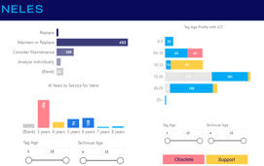
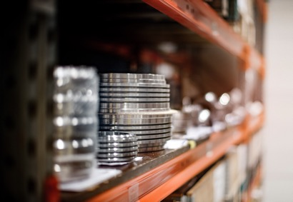
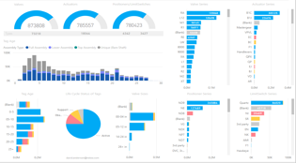
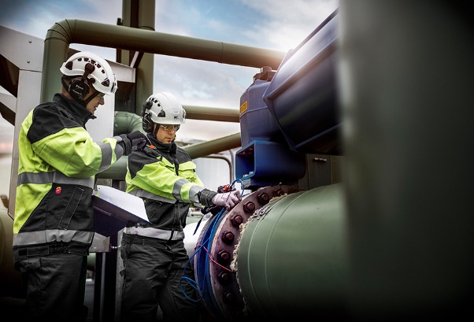
Operate, maintain and optimize
Inventory management
Installed base
audits
Avoid unexpected delays by addressing criticality, obsolescence, spares, and gaps in inventory.
Inventory management
Savings in storage space and working capital.
Inventory
analysis
Ensure you have all the right parts based on digital analysis of criticality, repair history and usage.
Tools, facilities, resources
Find the optimum balance between in-house and outsourced capability by partnering with Valmet.
Capital project start-up services
→
Operate, maintain and optimize
→
Shutdown services
→
Modernization and upgrade services
Notes:
When the plant shuts down unexpectedly, it is absolutely critical to have the right parts on hand. Neles works with you to optimize stocking levels based on the installed base. For each device, we consider many factors:
Criticality
Age
Application
Service history
Similar installations
We provide you with a detailed plan that delivers the optimum balance between in-house and outsourced inventory.

Slide 8

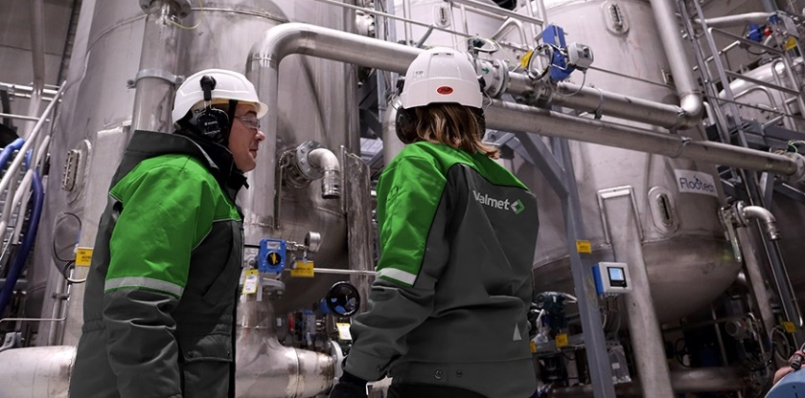
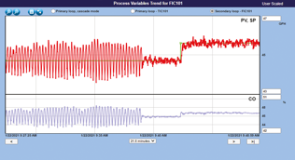
Operate, maintain and optimize
Optimize valves, controls and process
World-class software tools
Monitor your plant 24/7, with automated diagnostics for equipment. Optimize plant operations with controller tuning and interaction analysis.
Valve performance monitoring
Keep valves performing well, with
on-site and remote condition monitoring, plus expert advice.
Control performance
Achieve savings in chemicals and energy. Production increases through optimized controls. This turn-key service supplies the software, expertise, and best practices to bring bottom-line results.
Capital project start-up services
→
Operate, maintain and optimize
→
Shutdown services
→
Modernization and upgrade services
Notes:
Smart positioners and control systems are collecting huge amounts of data from your plant. By using software to monitor instruments, valves, and controls, we can help you to accurately diagnose the root cause of issues.
On-site and remote monitoring capabilities give you access to world-class experts and training.
With specific action plans to resolve the issues, savings can be in the millions of dollars / euros per year.

Slide 9

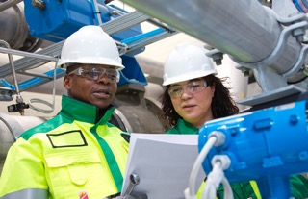
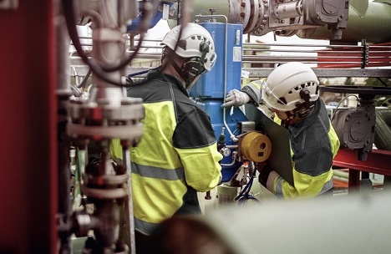

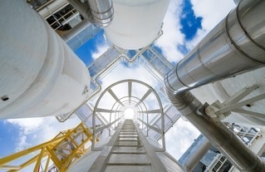
Shutdown services
Careful, data-driven planning combined with OEM expertise is the key to a successful shutdown
Planning
Materials, resources and scope optimally defined based on valve condition, service history, shutdown objectives and maintenance strategy.
Preparation
Maintain schedule by ensuring that all needed equipment, tools and resources are ordered, delivered, and prepared for installation.
Execution
Reduced risk and improved due to high-quality parts, skilled people and onsite supervision performed by our valve and smart product experts.
Start-up
Safe and smooth start-up using real-time digital diagnostics and expert personnel.
Evaluation
Raise the bar for future shutdowns, with expert advice
for follow-up, using lessons learned to improve maintenance and planning for the next shutdown.
Capital project start-up services
→
Operate, maintain and optimize
→
Shutdown services
→
Modernization and upgrade services
Notes:
Shutdown planning is a major focus for our reliability partner program. It may be many years until the next shutdown. We know that you only have one chance to get the work done right.
We work side-by-side with you, far in advance of the shutdown. Together, we properly plan the work so that materials and valves are ready, shop time is reserved, and shutdown work can be executed on-time without surprises.

Slide 10
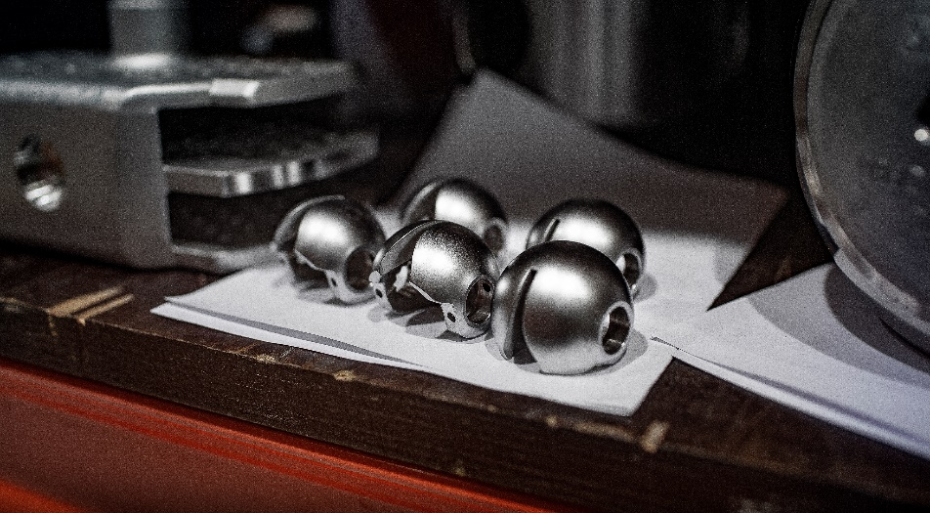
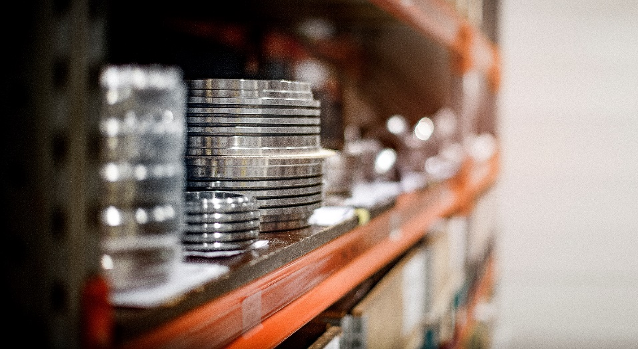
Flow control spare parts: OEM parts to maximize asset lifetime, secure operations, and improve safety
Guaranteed performance
Safe operations
Uncompromised Reliability
Leakage and Emissions under Control
Maximum lifetime
Global availability
High delivery accuracy
Ready made spare parts sets to ease the service work
Support for legacy valve series
Parts that match original materials and specifications
Base materials
Coatings
Dimensions and tolerances
Surface finish
Quality management and warranty
Notes:
Targets:
Performance, safety, reliability and economics.
Operations:
Global availability: Spares from 7 technology centers and ~40 service centers (+ partners)
High delivery accuracy: Spares on time delivery over 90%
Spare part sets: all small parts in one package, fast selection and nothing missing
Legacy valve support: Despite being obsolete, we will always do our best to get the parts even for the older series
Technicals:
Similar looking parts are not the same. Valve must work in the spec. Conditions (pressure, temp. Etc.) not just in test conditions.
Surface finish, coatins and base materials all correctly together ensure full operating timeline. -> fix it for years, not just for tomorrow
Same quality management as for the new products.
Warranty

Slide 11
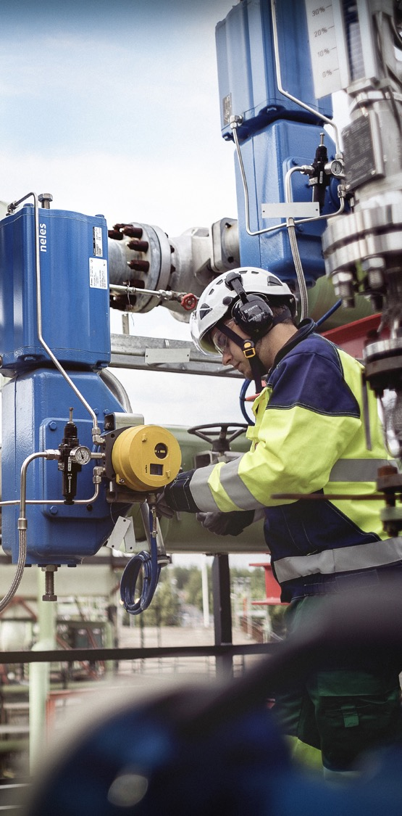
Examples of how we have helped our customers
Customer challenges
Actions
Results
European pulpmill running mostly in manual
Control performance services to resolve valve issues, tune controllers
EUR 3 million yearly chemical savings
Middle Eastern chemical plant seeking reduced turnaround costs
Optimal shutdown planning and execution aligned with maintenance objectives
Turnaround interval extended
by 2 years
South American petrochem plant with long MTTR
Inventory analysis based on criticality and maintenance history
Optimal inventory ensures minimal downtime
European refinery predictive
maintenance
Remote monitoring and analysis of valves and process performance
Reliability improvement, reduced unplanned downtime
Another European refinery seeks better inventory control
Turn-key inventory management outsourcing for all valves and valve parts
Maintenance and inventory budgets optimally allocated
Notes:
Note that these are 5 very different case studies.
The real customer names are revealed to our own people only:
Pulp mill in Europe = Illim Bratsk, Russia
After control performance optimizations, saw chemical reductions of 5-6% in caustic and in chlorine dioxide usage.
Chemical plant in the M-E = Qatar Chemicals
European refinery = Lotos, Poland
European refinery =Porvoo Kilpilahti, Finland
Control performance monitoring and valve performance monitoring have been proven to prevent reliability issues. This has resulted in millions of euros in savings per year. The return on investment from this program is many times the cost of the service.
South American petrochemical plant = Braskem Bahia, Brazil

Slide 12
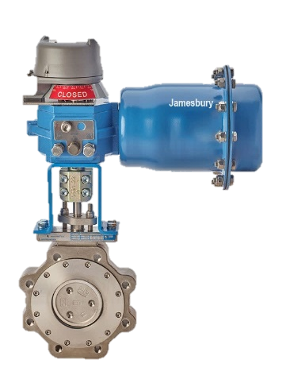
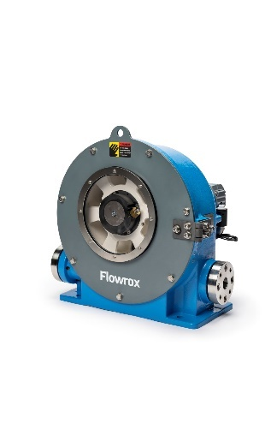
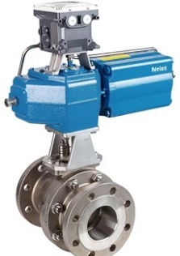
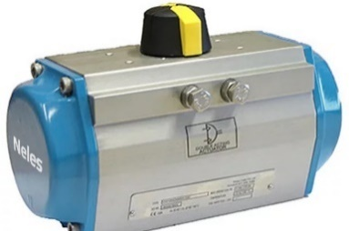
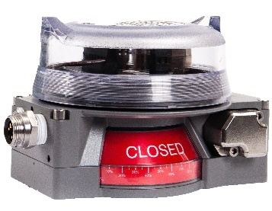
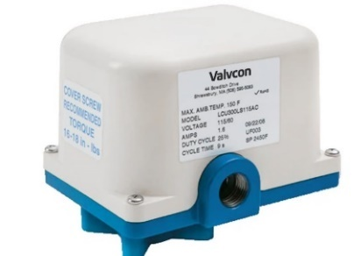
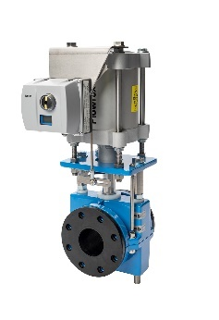
Our renowned product brands are a sign of reliability
Neles™
Premium engineered
flow control solutions
Jamesbury™
Premium performance
flow control solutions
Neles Easyflow™
High-performance
flow control solutions
Stonel™
Valve communication solutions for automated valve integration
Valvcon™
comprehensive range of electric actuators
Flowrox™
valve and pump solutions

Slide 13
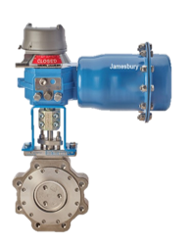
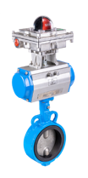
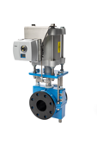
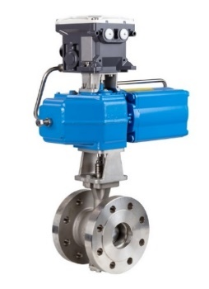
Comprehensive product portfolio
High-quality products for all pulp, paper and bioproduct applications
Valmet’s flow control solutions
High process performance delivered by advanced automation requires reliable controls in all sub-processes, such as:
Woodyard and recycling
Chemical pulp making
Chemical Recovery
Power generation
Paper, tissue and board making
Biorefining, chemical plants
Water & waste water treatment
Mill-wide bioproduct integration may include up to 15,000 valves to secure smooth process performance and operations.
Neles™
Premium engineered
flow control solutions
Jamesbury™
Premium performance
flow control solutions
Neles Easyflow™
High-performance
flow control solutions
Flowrox™
Valve and pump flow control solutions
Standard
and severe service control
valves
Engineered solutions
for pulp, paper and bioproducts
Automated
on-off
valves
Intelligent valve controllers
Improved reliability
in harsh environments
Extensive
ball and butterfly valves offering
Reliable performance
Notes:
We offer a full range of flow control solutions under strong product brands that are known and respected around the world.
Whatever the application and level of performance required, you will find the right products from our industry-leading portfolio.
All our product brands:
Neles
Jamesbury
Neles Easyflow
Flowrox
Stonel
Valvcon

Slide 14
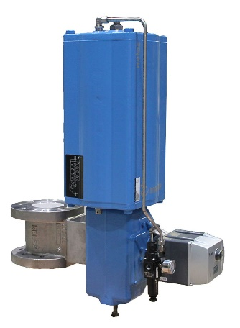
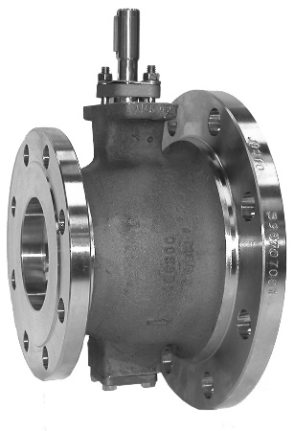
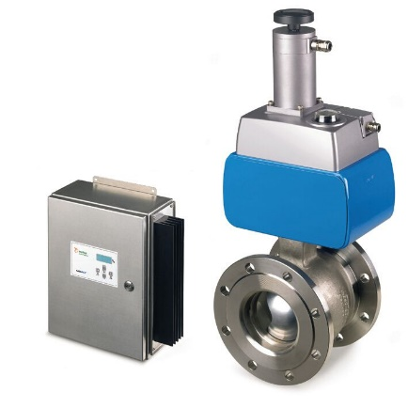
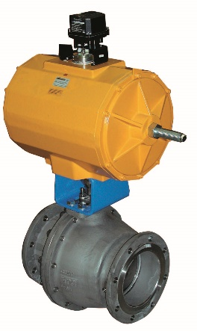
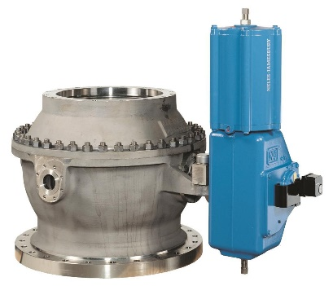
Engineered for PPB
Industry-specific valves
Neles® Capping valve,
Series PZ
Neles® Ceramic
ball control valves,
Series E2 and E6
Neles® R-series
V-port segment valve
for MC-application
NelesAce®
basis weight
control valves
Neles® M1/M2
Pocket Feeder
Automatic opening and closing of batch digesters for chip fill e.g. dissolving pulp process
Wearing and abrassive applications:
lime, lime mud,
slurries, coaters
MC-pumping control:
Optimized flow path for high consistency applications 8-19%
Basis weight control:
One of the most critical applications for valves
in paper machines
Automatic removal
of sand and other
fine debris from
a process

Slide 15








Locations around the world
Global presence means reliability for you through our service centers
valve technology centers
8
service centers
~ 40
authorized service partners
13
Notes:
Wherever you find our customers, that’s where you will find us. We have 8 valve technology centers (R&D and manufacturing), in Finland, USA, Germany, South Korea, India and China as well as a global sales, service and customer support network, all ensuring that our customers always have access to the products and services they need.

Slide 16
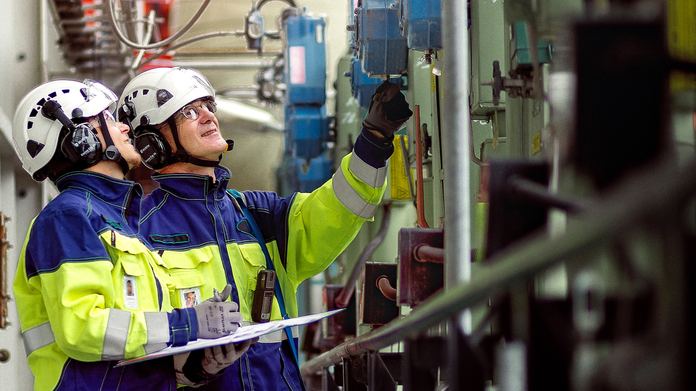

Your reliability partner.
Global expertise, applied locally.
Digital tools, delivering actionable insights.
Best practices, leading the industry.
Notes:
Coming back to the main topic here: We want to be your partner. To better understand your needs, and to work side-by-side with you.
Let’s discuss the main ways that we can help you…

Slide 17

Obrigado
Regis R. Alves
15 9 9717 4521
regis.alves@valmet.com

