Slide 1
Marketing expo demonstration
S&OP LatAm 2025

Slide 2
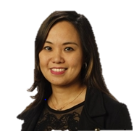
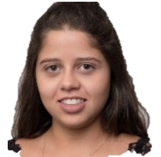
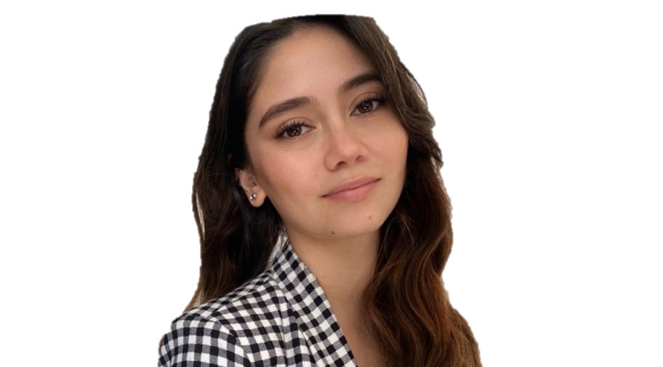
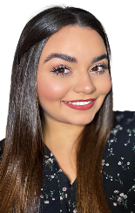
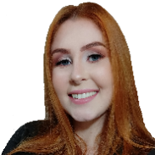
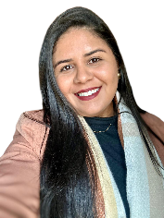

Marketing Latin America (LatAm)
Fernanda Maia
MKT Pulp, Energy
and Circularity
MKT Packaging and Paper
& Tissue
MKT Services
(PAC /PEC)
MKT BAs support
Bruna Silva (partner)
Digital and Trade MKT (2026)
Camila Iann
Internal Comms + Website
Luis Gaona (partner)
Fernanda Maia
Luiza Callado
Bárbara Arroyo
Ariadne Azeredo
(Sucuriú project)

Slide 3
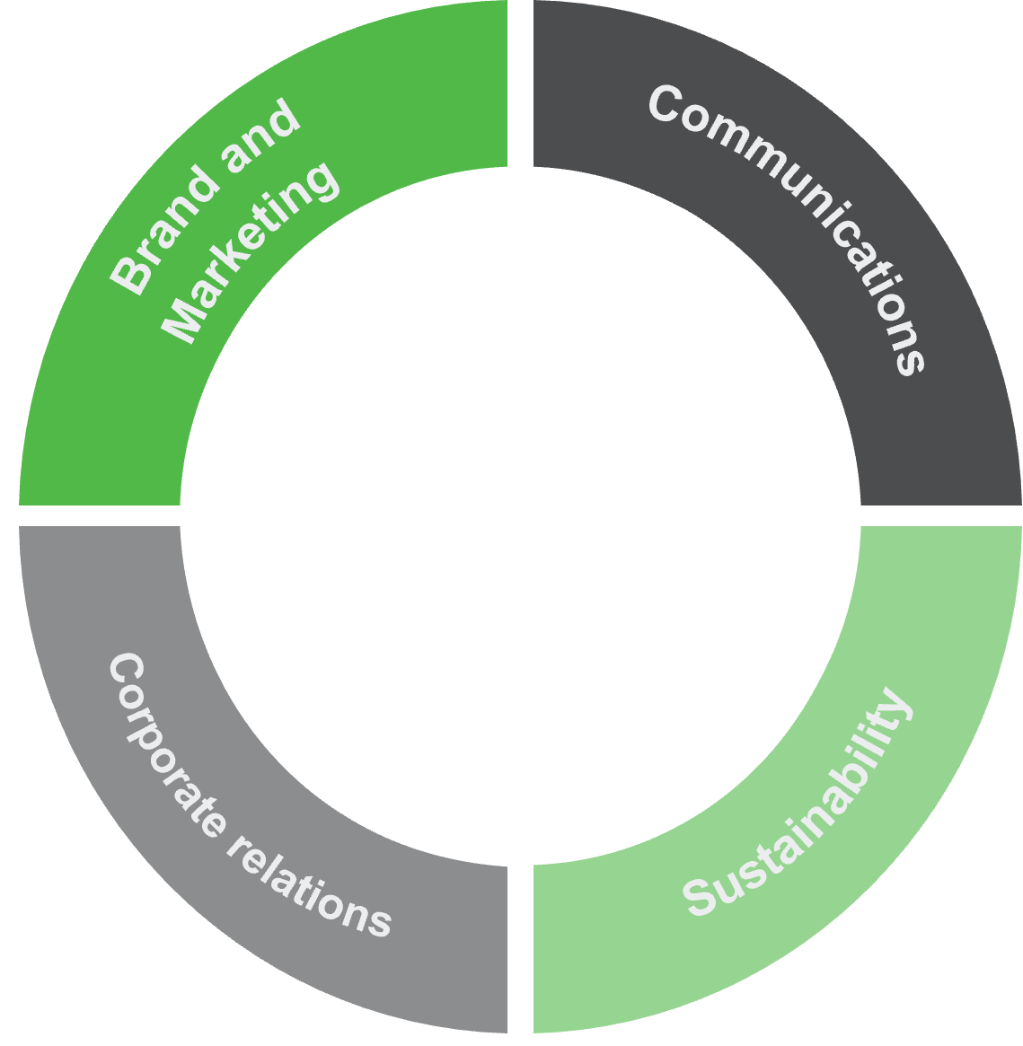
Marketing responsibilities
Strategic Planning & Budgeting
- Annual planning aligned with business priorities
- Budget follow-up and provision for marketing activities
Content Development
- Local and global content creation related to LatAm BA (articles, videos, banners) - - including Flow (internal channel)
Translations and scheduling of publications
Forward Magazine process (meetings to discuss topics, content development, review, supplement translation review)
Campaigns
- Organic campaigns
- Strategy definition, asset creation, performance tracking
- Localization of global campaigns

Slide 4
Marketing responsibilities
References
- Success stories development and promotion
- Customer approvals, photoshoots, global alignment
Events
- Trade fairs, seminars, Valmet events
- Planning, logistics, branding, lead generation
- Event communication and post-event coverage
- Post-event reporting
Merchandising
- Design and purchase of promotional items
- Inventory control and distribution
Digital Marketing
- Website content localization and updates
- Social media content creation and scheduling
Business & Partner Support
- Sales materials (presentations, leaflets)
- Branding alignment and event support for partners

Slide 5








External Events
Marketing Content
24
Q2
Expomin - CHI
ABTCP - Seminário de Automação - BRA
ABTCP - 7º Workshop de Embalagens - BRA
Direct Lithium Extraction Argentina - ARG
ABTCP - 7° Seminário de Celulose - BRA
CMP - MEX
Webinar Forno de Cal - ONLINE
ABTCP - 29° Seminário Recuperação e Energia - BRA
LatamPaper - BRA
Feeders Seminar - BRA
Arauco SIM Dinner - BRA
Q3
6º Congreso Internacional y Exposición Minería Perú y América Latina - CHI
Mesa Redonda ABTCP | PGs – ONLINE
OPEX - BRA
FastMarkets - BRA
ABTCP - 13º Semana de Celulose e Papel - BRA
Tissue Summit Latam - CHI
Tailings - CHI
Packaging Summit Latam - CHI
Ads
References
4
O Papel Magazine
6
# performed
2
Q1
Packaging Summit - BRA
Tissue Summit - BRA
Acotepac - COL
Fimec - BRA
Desalination Latam - CHI
Celulosa y Papel Mag.
3
Milestones
Minería Chilena
2
22
13
Rumbo Minero
Leads per BA *October
PAC: 3
PEC: 1
SER: 0
PAC/TS
Leads (YTD)
Products
PEC
348
Campaigns
13
16
Target: 342 YTD
Social Media
Media / Press
Marketing KPIs
2025 – until October
Reach priority media:
37,41M YTD
Number of posts:
245 YTD
Target: 270
135.897
1163
Priority
publications
Target: 40M
31*
BAs
SER: 8
PAC: 7
PEC: 4
Engagement
Target: 134.000
Media Priority Valuation
4,04 MEUR
Engagement rate 13,9%
Target: 8%
YTD
YTD
* October
Target: 4MEUR

Slide 6
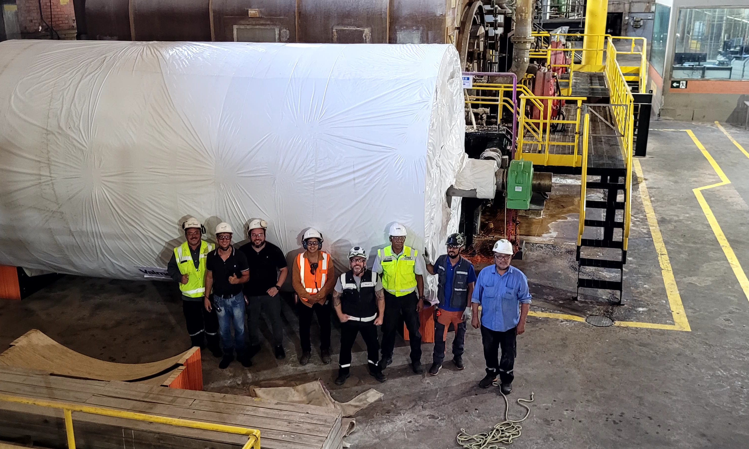
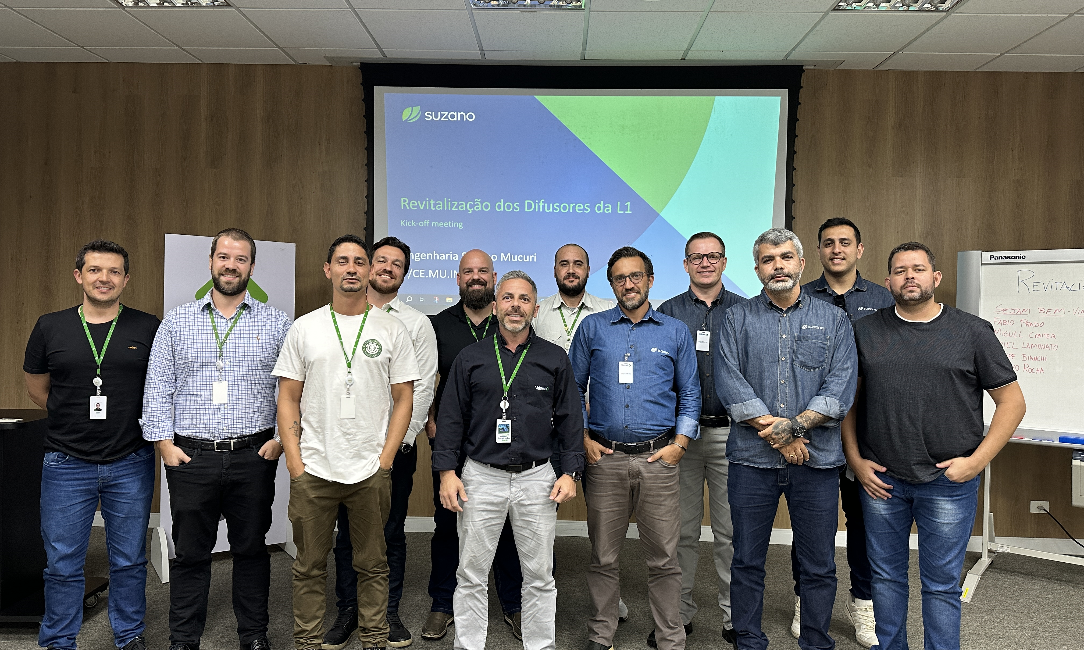
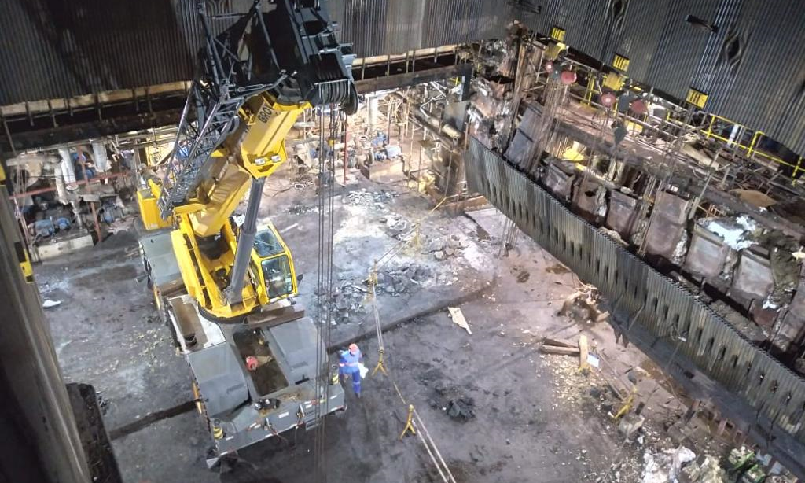
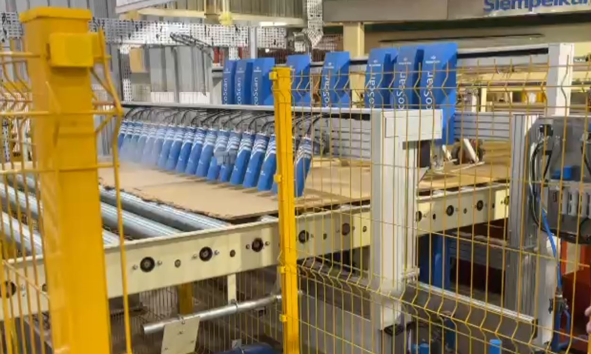
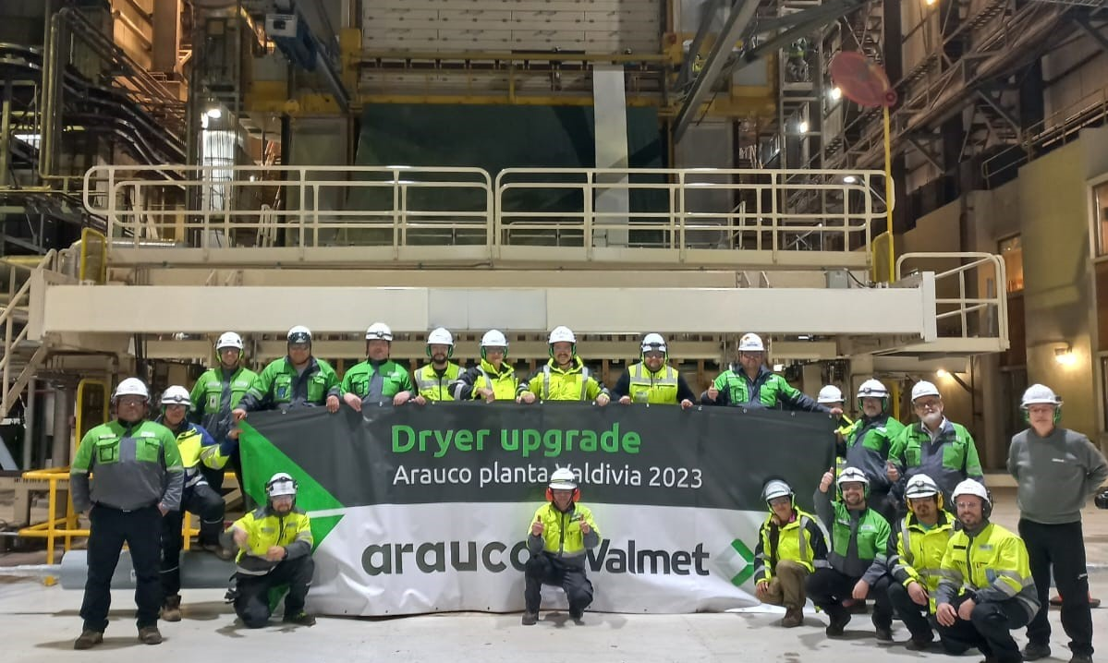
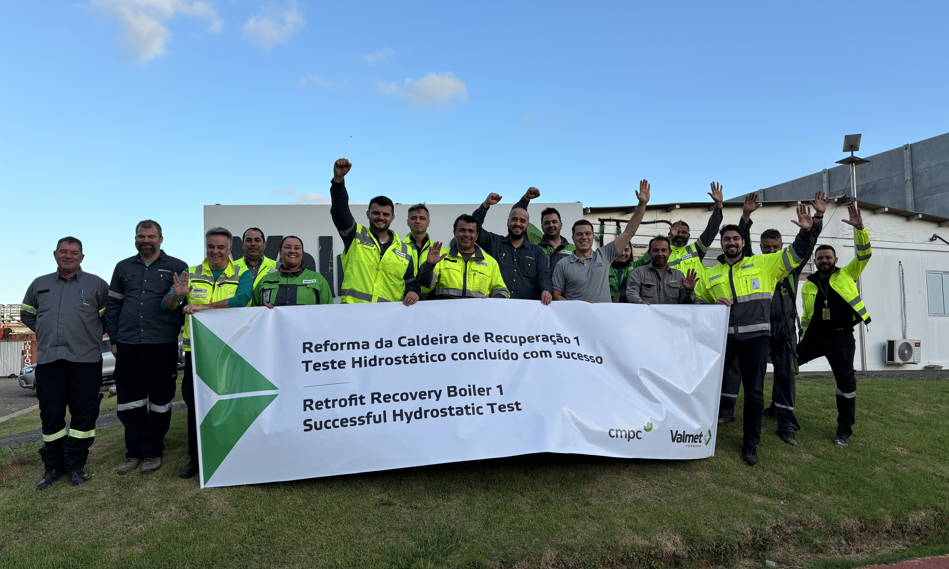
MKT close to sales and project execution
SER projects milestones
Sylvamo
Suzano - Mucuri
Suzano - Aracruz
Guararapes
Arauco
CMPC

Slide 7






MKT close to sales and project execution
Products campaign
Electrostatic Precipitators
Wash Press Services
ROL Service Center
Filtration
Black Belt
FSE Experts

Slide 8
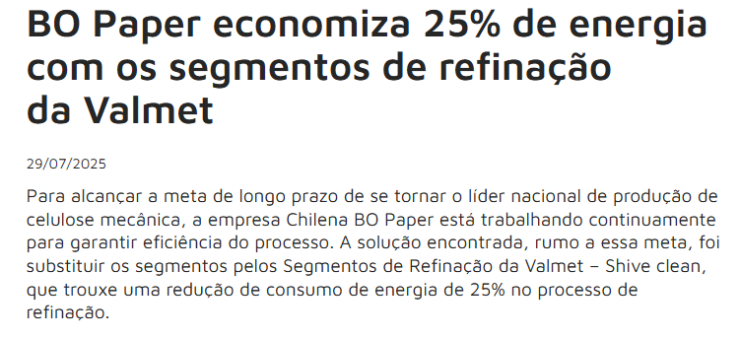
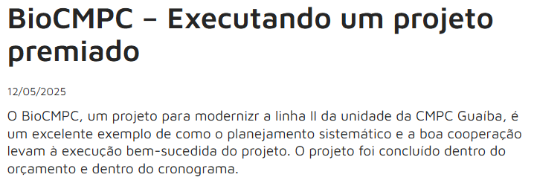
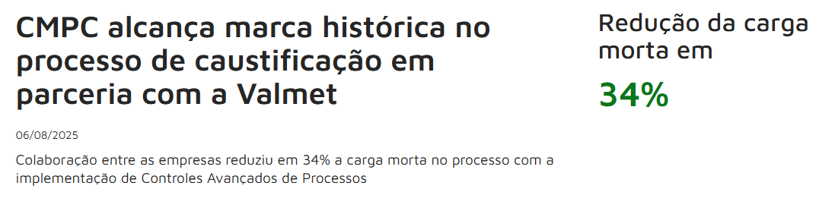
MKT close to sales and project execution
References

Slide 9
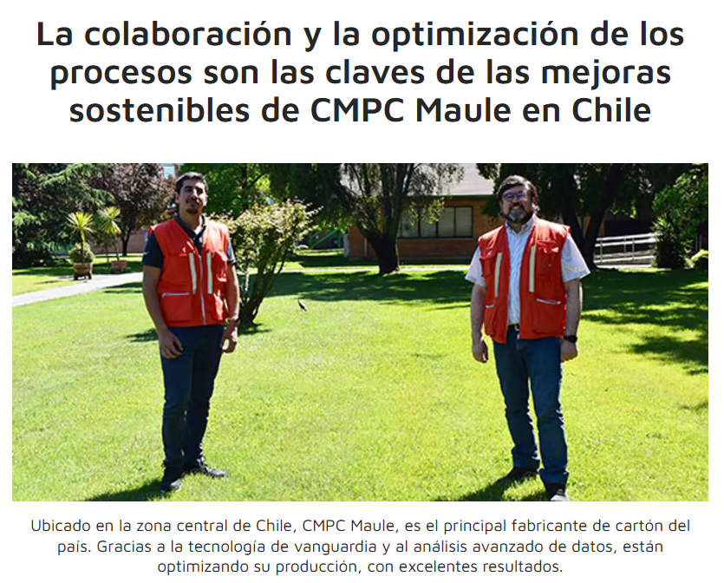
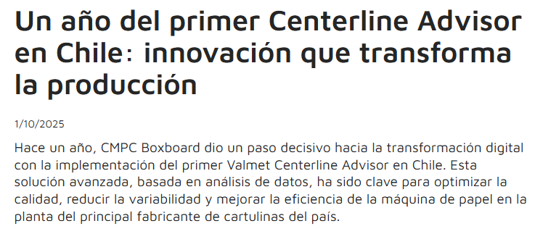
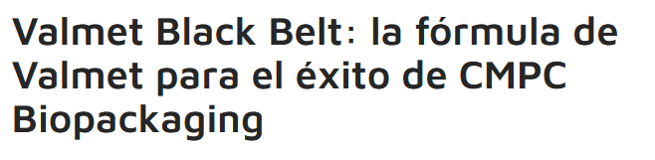
MKT close to sales and project execution
Customers stories

Slide 10
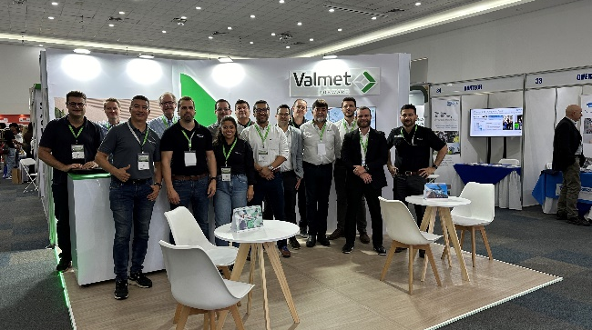
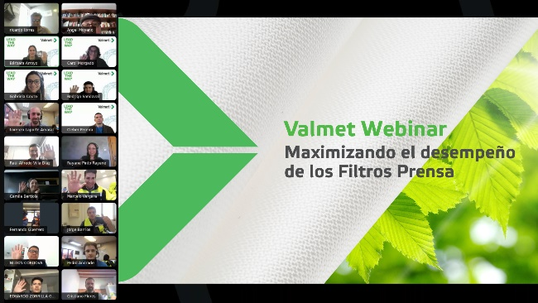
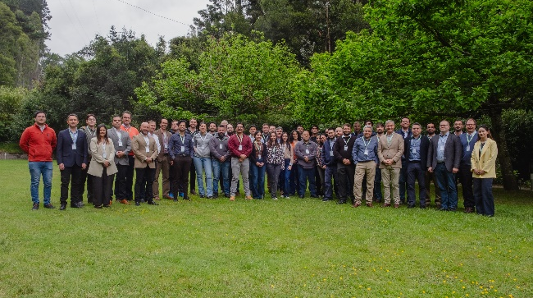
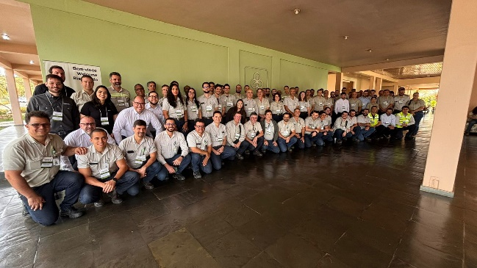
Events
External event
Webinar
Customer seminar
Tech Day
Large-scale industry gatherings where we showcase products, services, and innovations to a broad audience. These events are designed to increase brand visibility, generate leads, and strengthen market positioning.
Online events that allow participants to join remotely. We use webinars to deliver presentations, training, or product updates in a convenient, interactive format that includes Q&A sessions
Exclusive, topic-focused events organized for customers. The goal is to share in-depth knowledge, present solutions, and foster stronger relationships through direct engagement.
Smaller, highly targeted sessions held at customer sites, typically lasting a full or half day. These events focus on a specific technical topic, providing hands-on insights and practical discussions tailored to the customer’s operations.

Slide 11
MKT workflow
for marketing content creation
Information Capture (Sales → Marketing)
Sales shares updates: projects, milestones, customer success stories.
Prioritization
Marketing evaluates:
Strategic relevance
Timing
Available resources
Content Creation
Marketing drafts and designs.
Sales reviews critical details such as technical information
Format Definition
Decide if it will be a social media post, website/external article, newsletter, video, or webinar.
Technical validation is needed from Sales
Publication and Distribution
Marketing publishes on official channels, after customer validation.
Sales amplifies through personal networks and customer sharing
Feedback Loop
Sales reports impact Marketing tracks metrics (reach, engagement, etc).

Slide 12


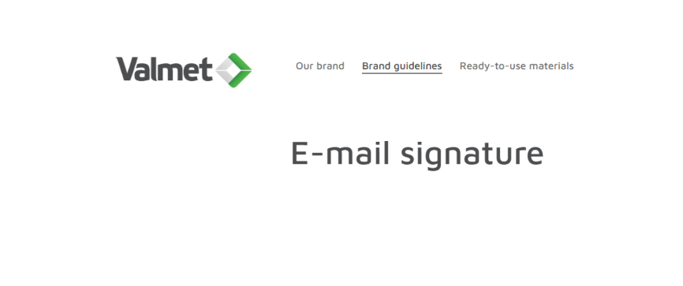
Strengthening our brand
Brand Center
Media bank
Email signature
in the Brand Center you will find guidelines, materials and dynamic templates to help you implement the brand in your daily work and to maintain a consistent corporate identity.
https://brandcenter.valmet.com
Valmet Media Bank is a place to download original Valmet media files and pictures. Media Bank is also an easy and safe way to share files to your colleagues or outside partners by creating collections.
https://mediabank.valmet.com
At Valmet, we brand our emails with a professional looking signature. It makes us look trustworthy and creates brand recognition.
In the Brand Center you can find general principles for the signature and guidelines for the content.
https://brandcenter.valmet.com/document/34#/office-communications/e-mail-signature:7496

Slide 13




Guidance for 2026
Define priorities
Strengthen sales collaboration
Focus on high-impact action
Data-driven decisions
Empower and innovate
Celebrate wins!
Strategic roadmap to plan next year, new beginning

Slide 14
Final message
Collaboration is key
Marketing, Sales, and Services achieve the best results when they work together. Each team brings unique strengths that complement one another.
Clarity of roles
Marketing drives visibility and demand, Sales builds relationships and closes deals, and Services ensures long-term customer success. Recognizing these roles keeps the process efficient and focused.
Communication creates value
Open information sharing and aligned goals transform content into real value for customers and for the business. Collaboration isn’t just about working together; it’s about creating impact.

