Slide 1


LatAm SER S&OP 2026 - EXPO
Station 7 – Why negotiate critical themes during commercial phase? ( And not leaveto be “solved in the contract”)
Ana Carolina Santos

Slide 2


Why are we talking about this?
Commercial discussions often progress without addressing critical issues that affect risk, pricing, and the operational feasibility of the business.
When these matters are raised only during the contractual phase, they typically lead to significant delays, costly rework, and can jeopardize the client relationship.
If the issue involves monetary costs, these are often not included in the price contingency.
LatAm Legal Department

Slide 3


What should be negotiated during the commercial phase?
Liquidated Damages
Mechanical Warranty
Why negotiate early?
Out-of-range penalties can compromise the sales margin.
Observe the limits of the Contract Policy (Delay: 15% – Performance: 15% – Aggregate: 20% of the net contract price).
If defined late, they can trigger intense debates and block contract signing.
Assure the sole remedy and compensation nature of the liquidated damages.
Why negotiate early?
Direct impact on internal costs, spare parts availability, and technical team resources.
Extended warranties have commercial value and cannot be granted during the contractual phase without a price review.
They are limited to Valmet’s scope of supply.
Must consider all standard exclusions from the Guarantee Policy.
LatAm Legal Department

Slide 4


What should be negotiated during the commercial phase?
Contract Termination
Limitation of Liability
Why negotiate early?
Establish rules and impacts in case of early termination of the contract.
Define what happens with costs already incurred, materials, mobilization, and demobilization.
Without prior alignment, this can lead to significant financial losses and legal disputes.
Why negotiate early?
Set the maximum liability cap for Valmet in case of damages, according to the limits of the Contract Policy.
Protect the business against disproportionate risks.
Without clear limits, the contract may expose Valmet to unlimited liabilities that were never priced during the commercial phase.
LatAm Legal Department

Slide 5


What should be negotiated during the commercial phase?
Exclusion of Indirect Damages
Why negotiate early?
Exclusion of any indirect damages such as loss of profit, production downtime, market loss, etc.
These damages can have a multimillion-dollar impact.
There is no predictability.
Our insurance does not cover indirect damages.
This is a standard exclusion and must be negotiated already in the commercial proposal.
LatAm Legal Department

Slide 6
What happens when these issues are left for the contract instead of addressed during commercial negotiation?
Contractual Phase | Fase comercial
Rework between Commercial, Legal, Engineering, and Finance. | Greater clarity and transparency with the client
Delay in the signature of the contract | More complete and competitive proposals
Last-minute pressure for concessions | Fewer surprises and less friction — contracts simply formalize what was already agreed
Risk of margin loss | Reduction of legal and financial risks
Risk of operational misalignment | Increased client confidence in the organization
Strain on client relationship | Faster contract signing
LatAm Legal Department

Slide 7
Managing Exceptions to Valmet’s Contract Policy
Final denial by the Client
Draft of deviation request (supported by Legal)
Submit for approval of VP of Services for LatAm
Submit for approval to the CEO (Section A) or BA President (Section B)
Signature of the contract in accordance with deviations approved
Valmet Contract Policy
Procedure for Deviation
to the VCP approval
LatAm Legal Department

Slide 8
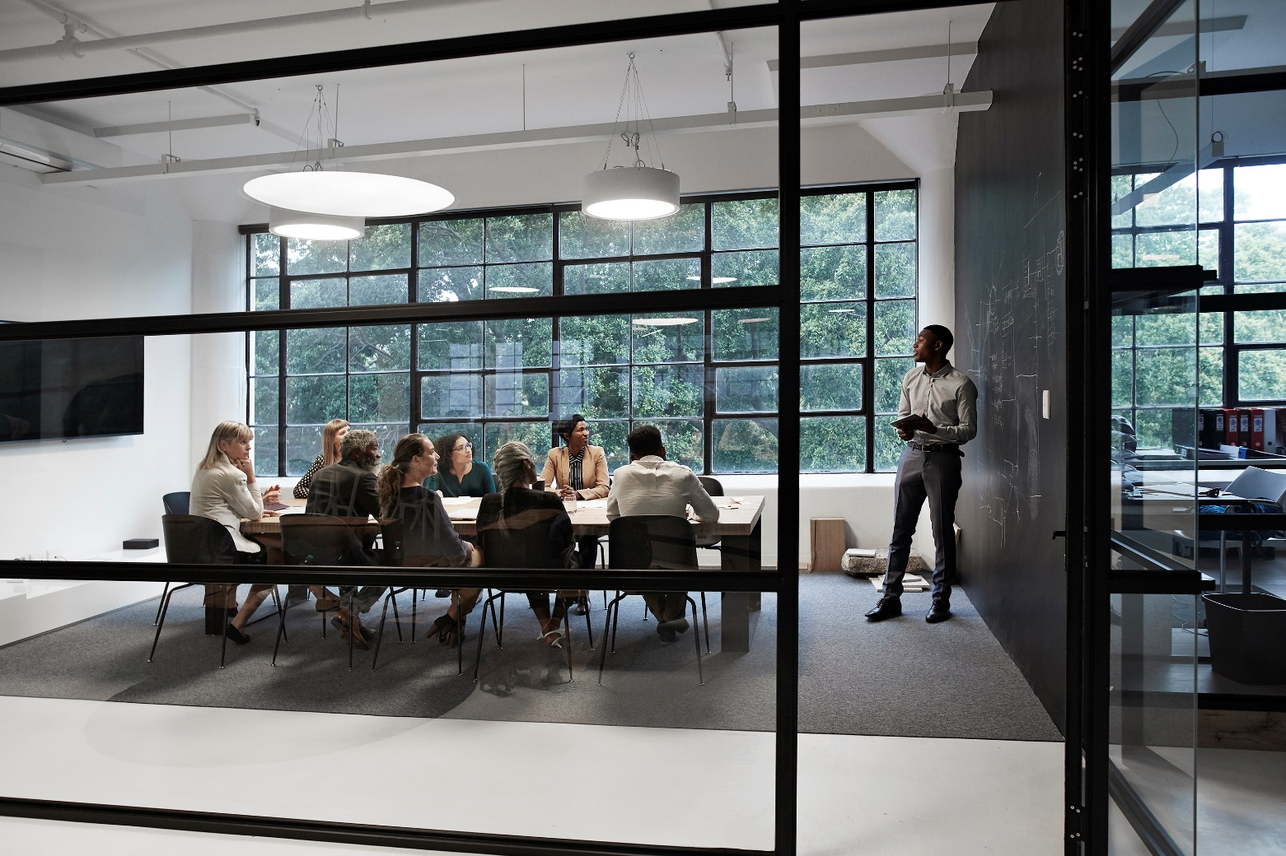
Strong contracts reflect early alignment, not last-minute decisions.
Anticipate critical discussions
Involve technical teams and Legal whenever necessary at an early stage of discussions
Price accurately
Document all negotiated terms in writing
Know Valmet’s Contract Policy!
Stronger negotiations, faster contracts, smoother execution, and effective protection of margin and business.
LatAm Legal Department

Slide 9


